Slide 1
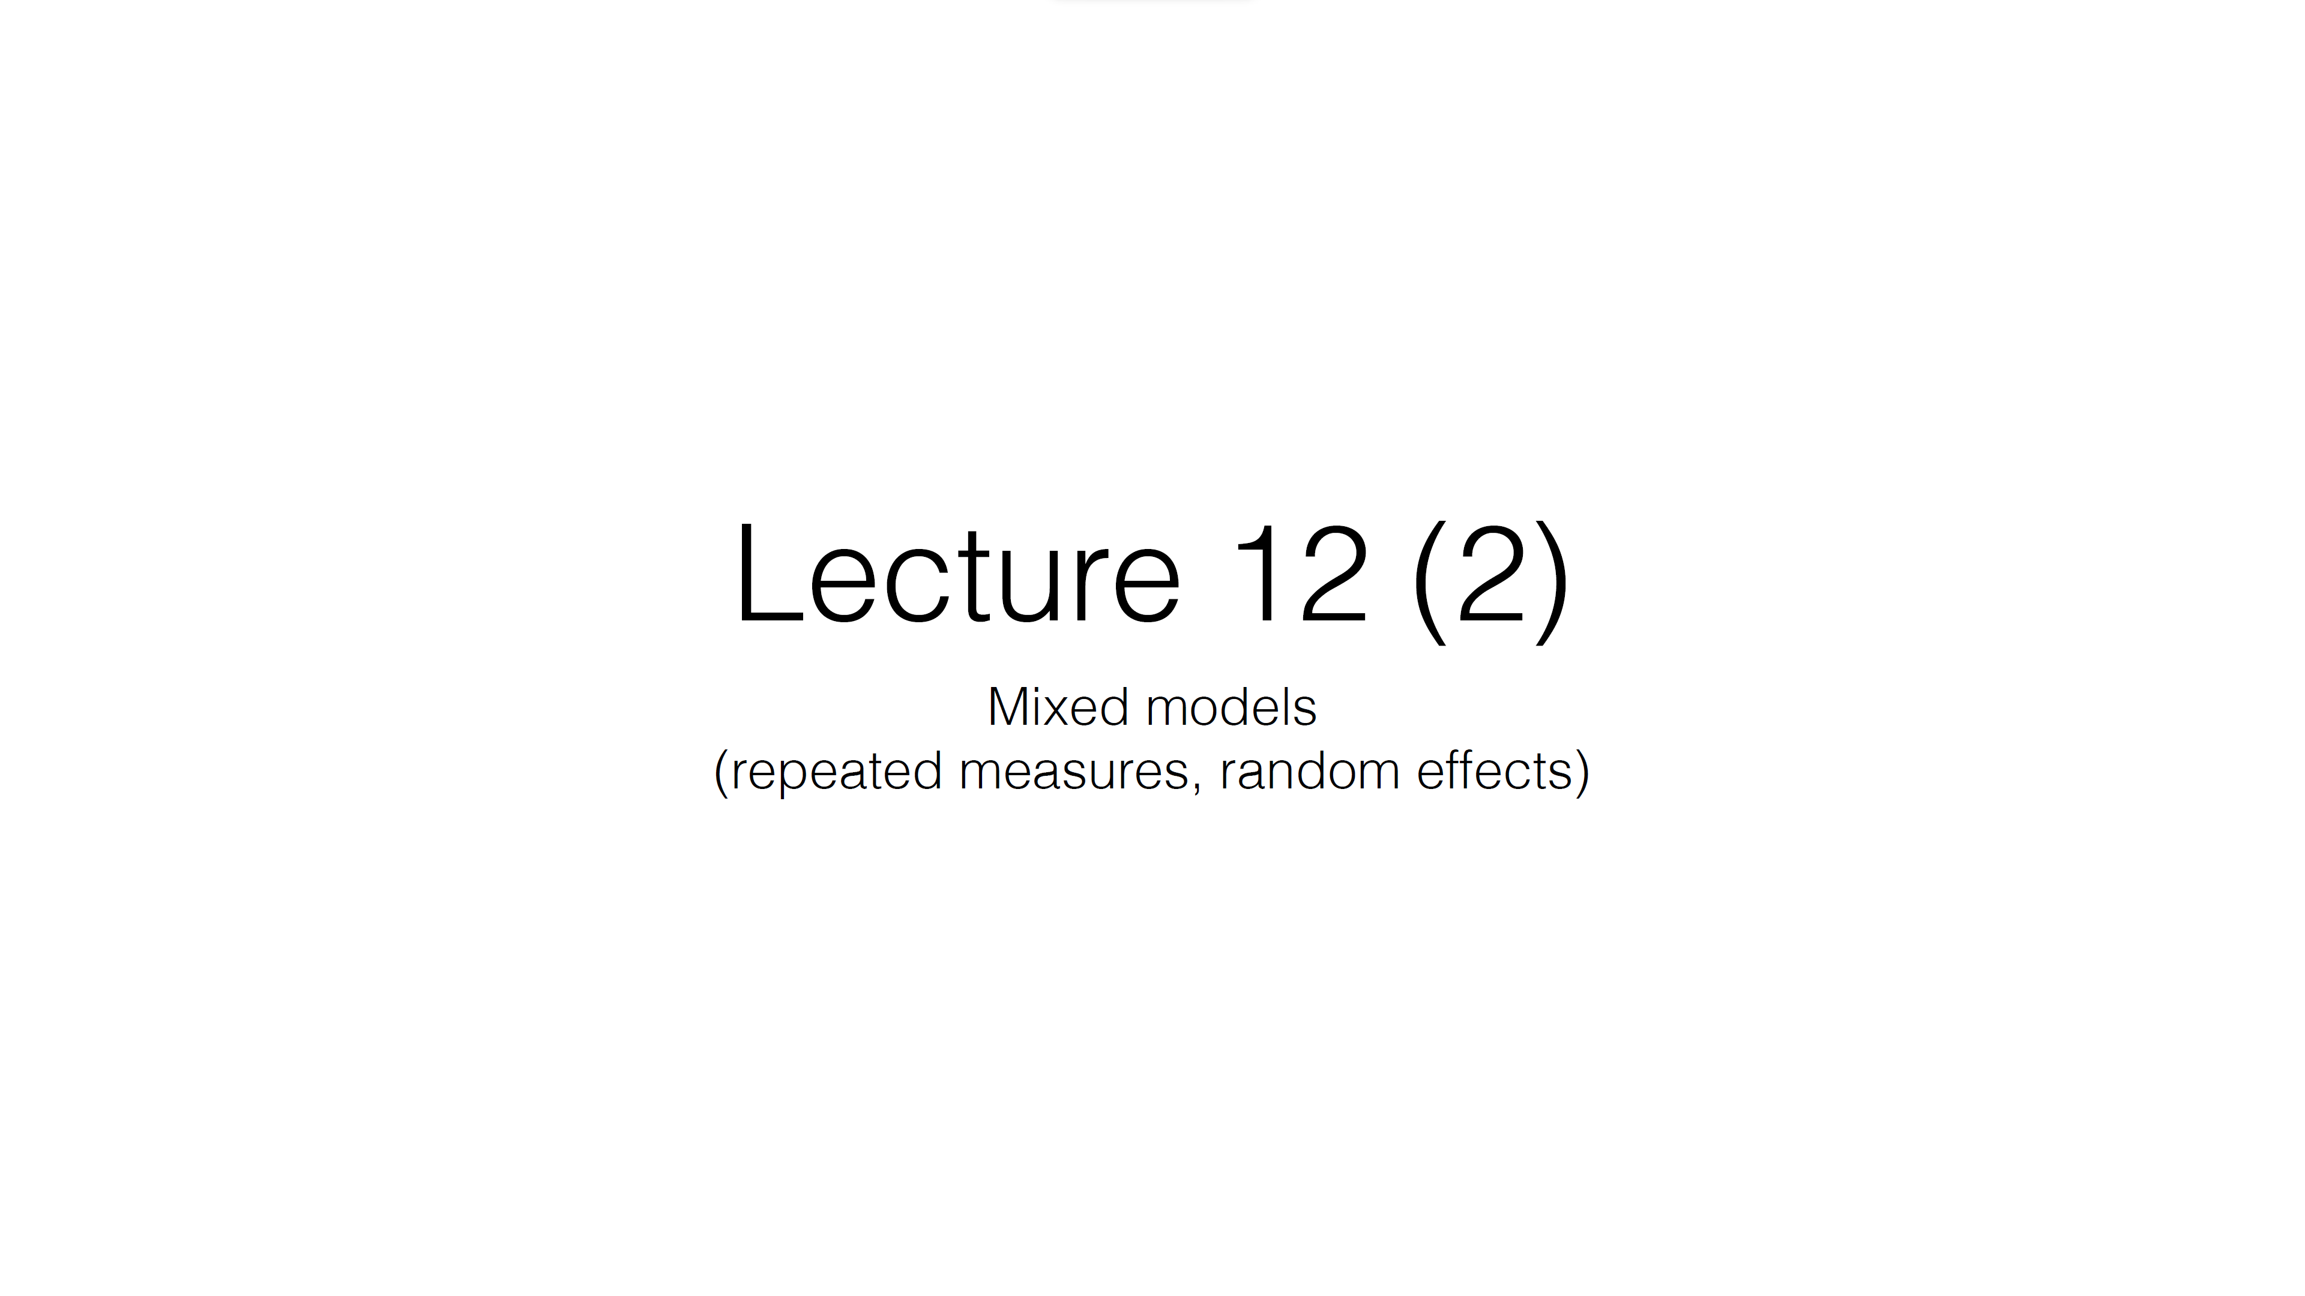

Slide 2
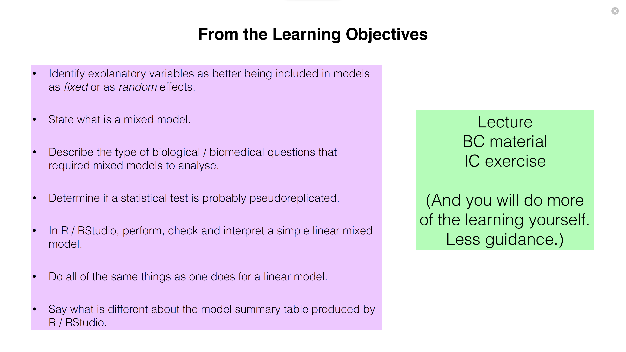

Slide 3
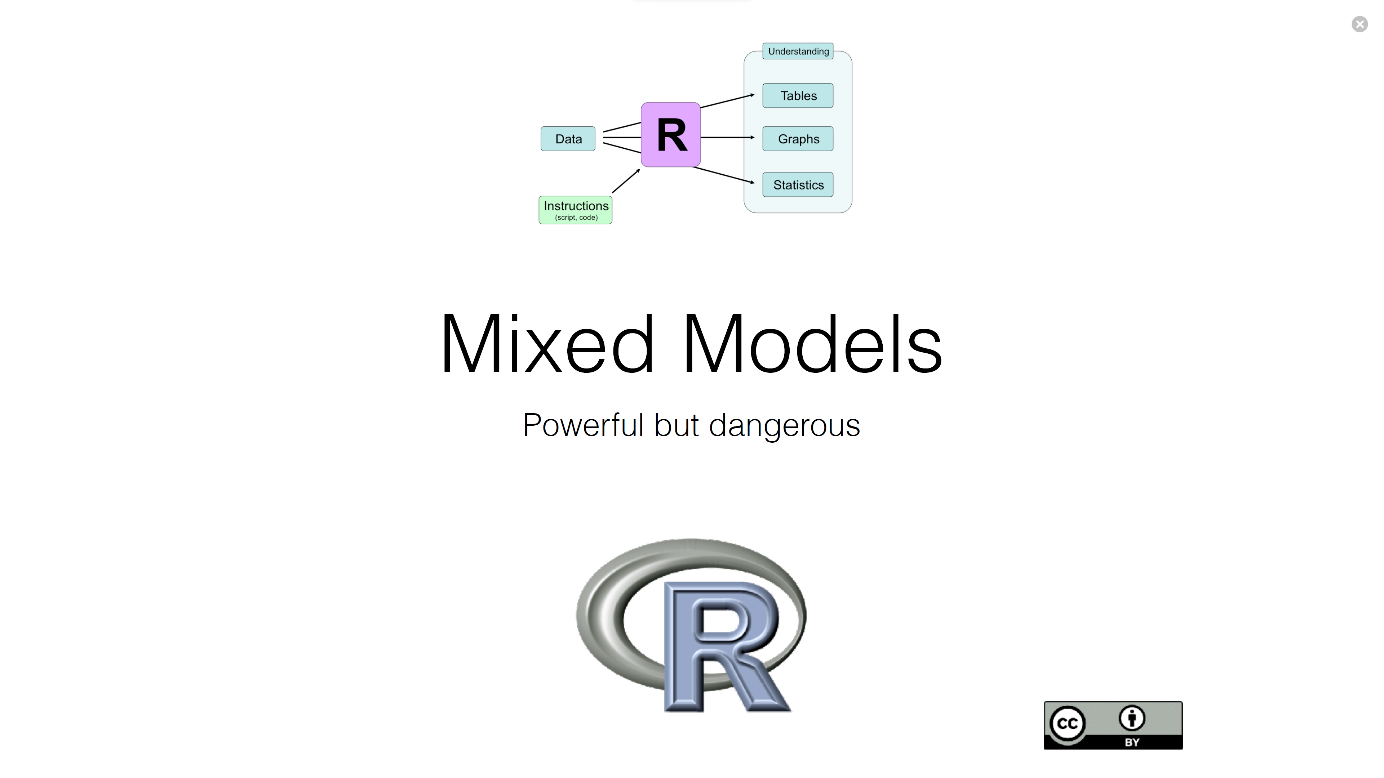

Slide 4
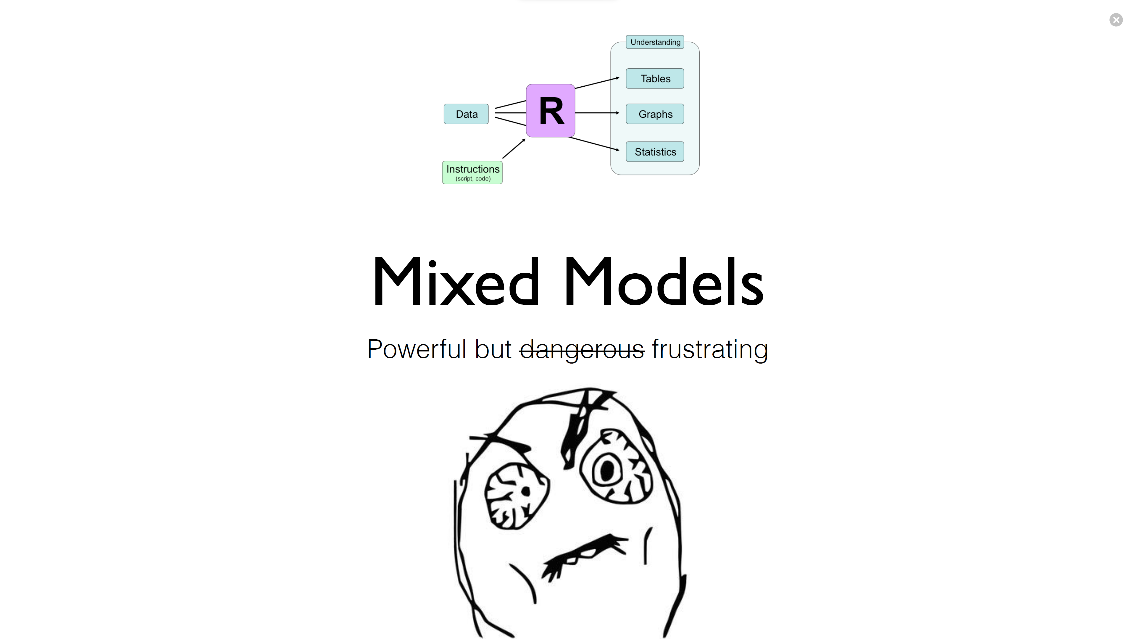

Slide 5
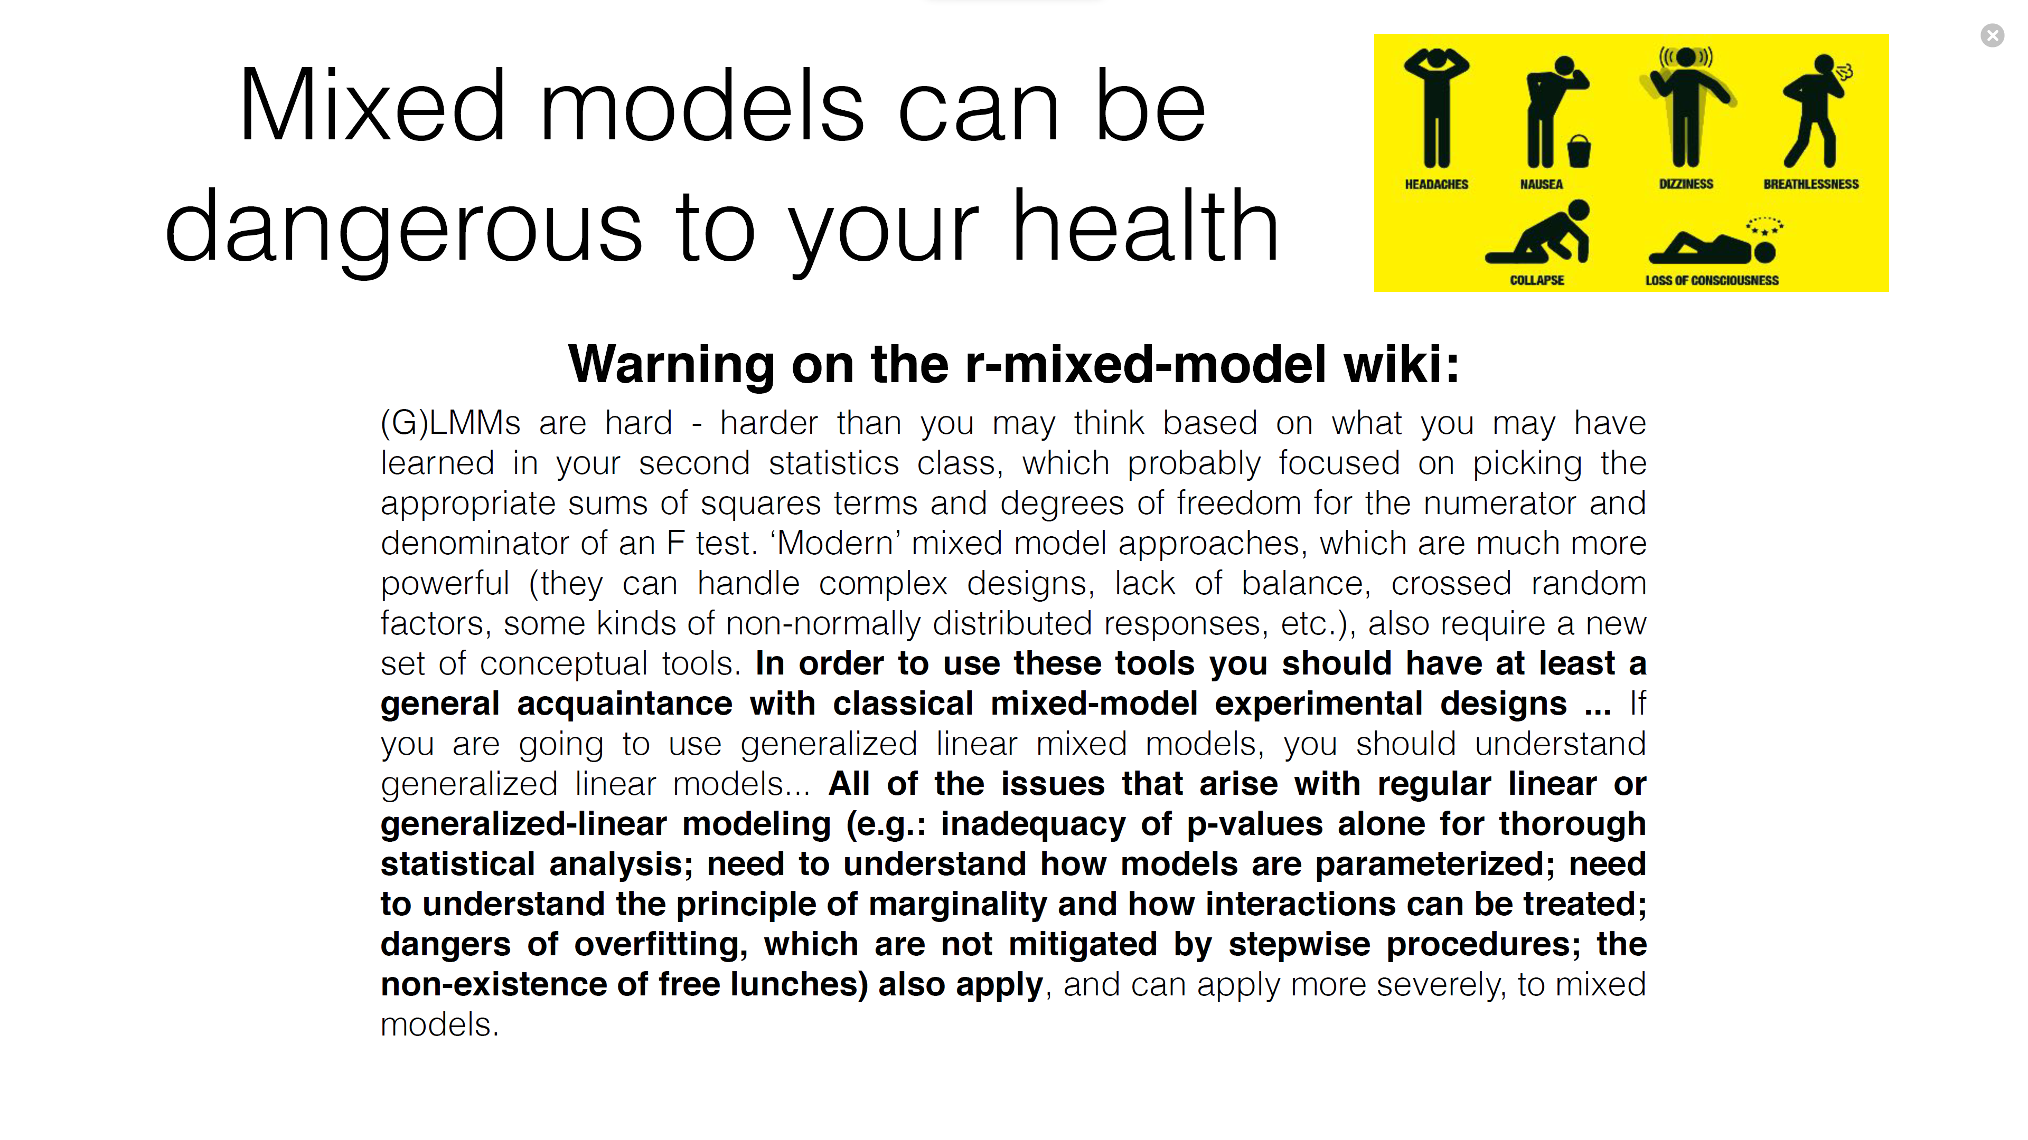

Slide 6
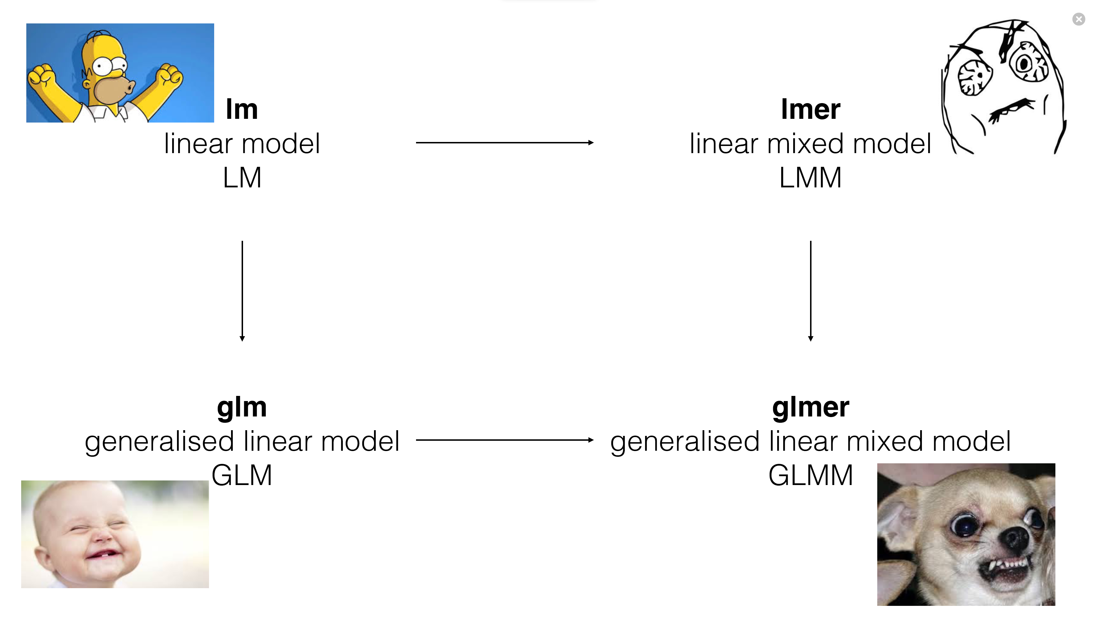
Model residuals follow a normal distribution, but observations are not independent
Model residuals follow a non-normal distribution, and observations are not independent either

Slide 7
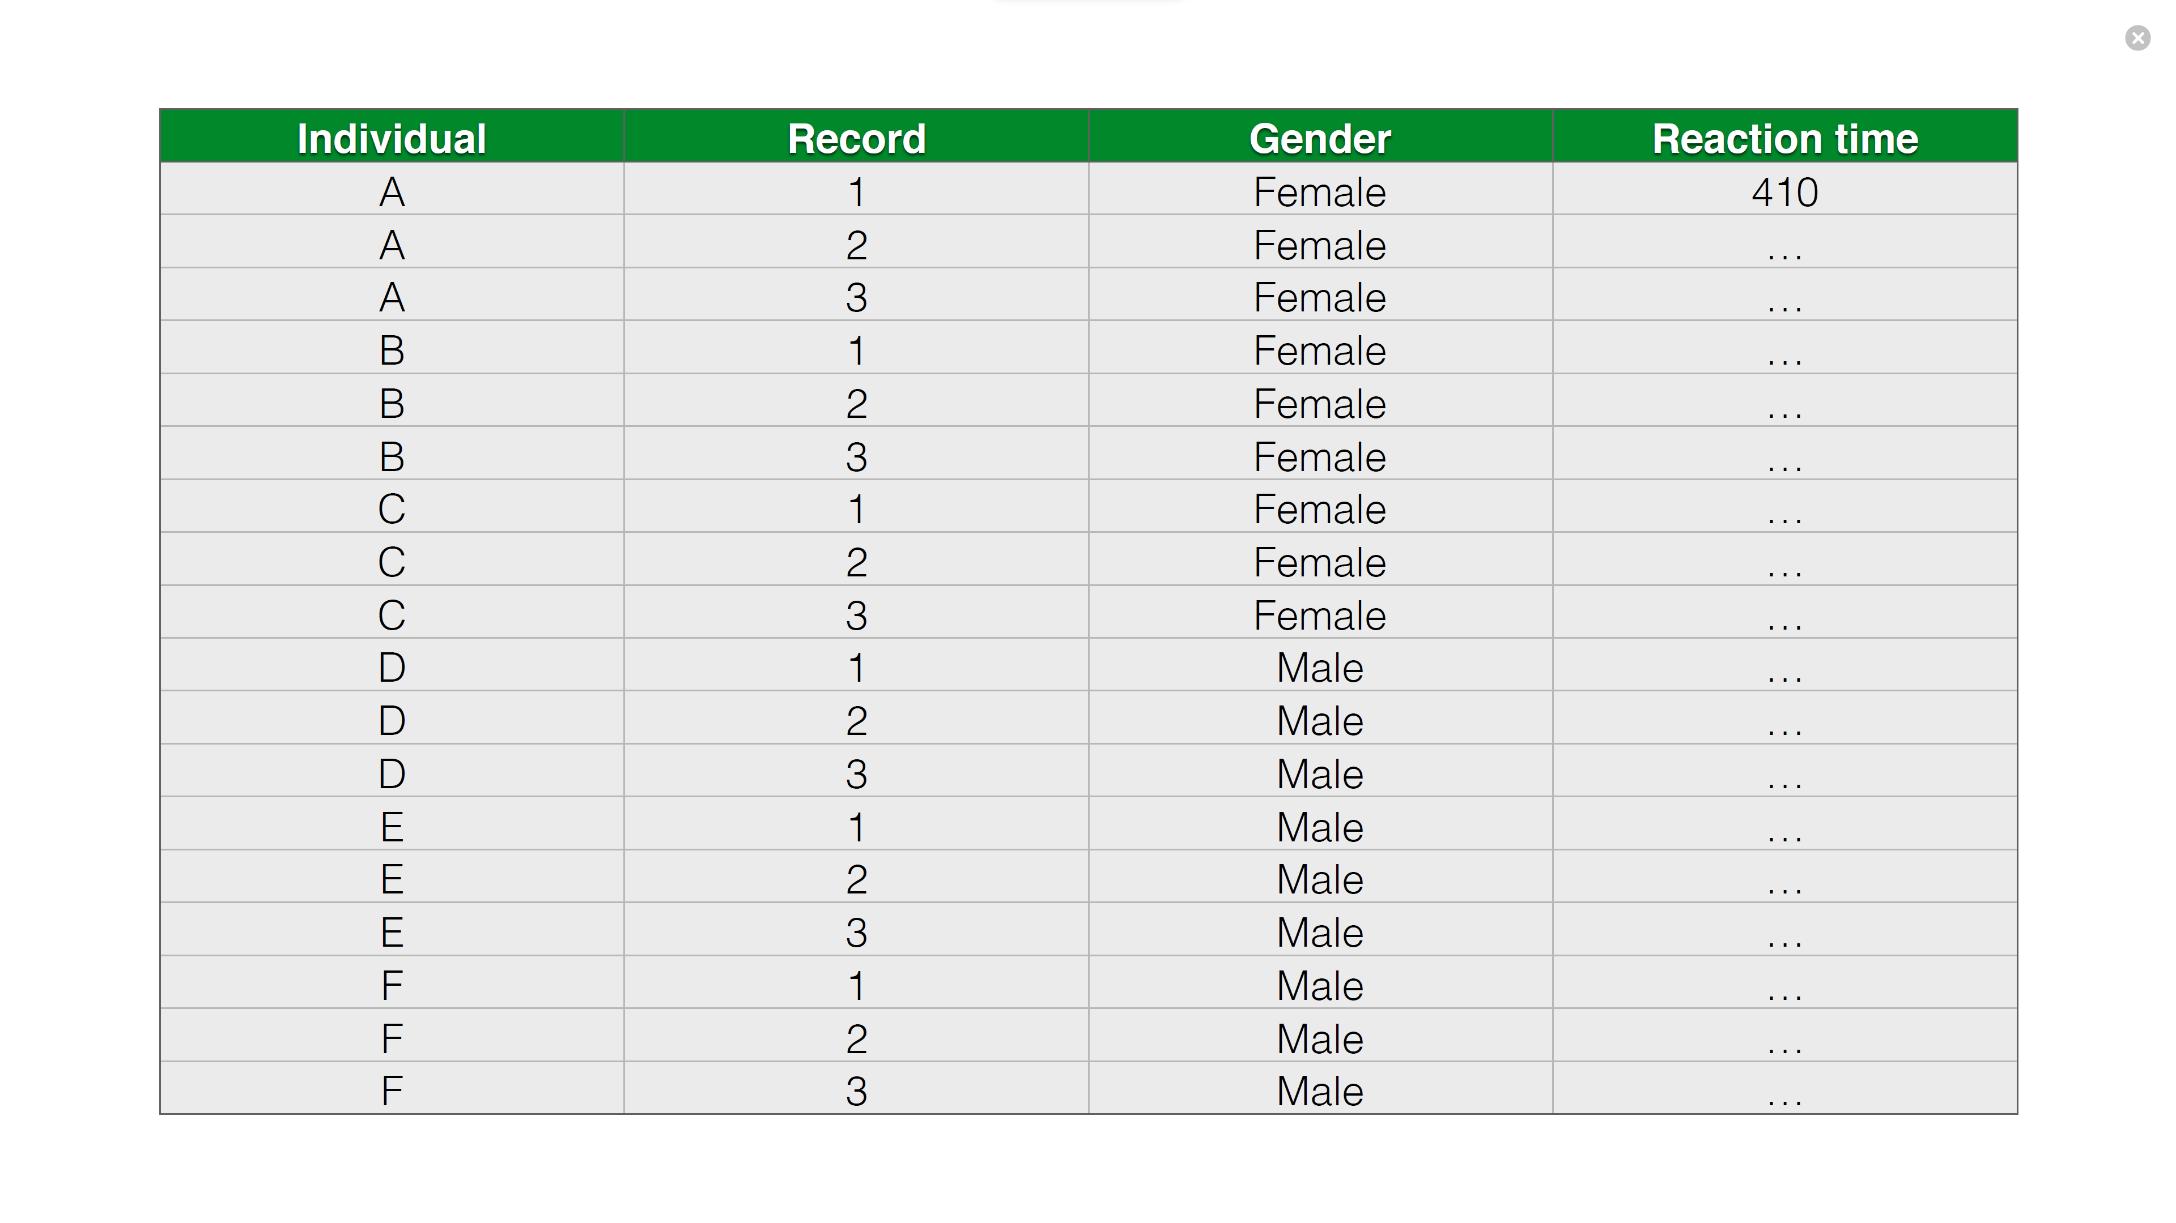

Slide 8
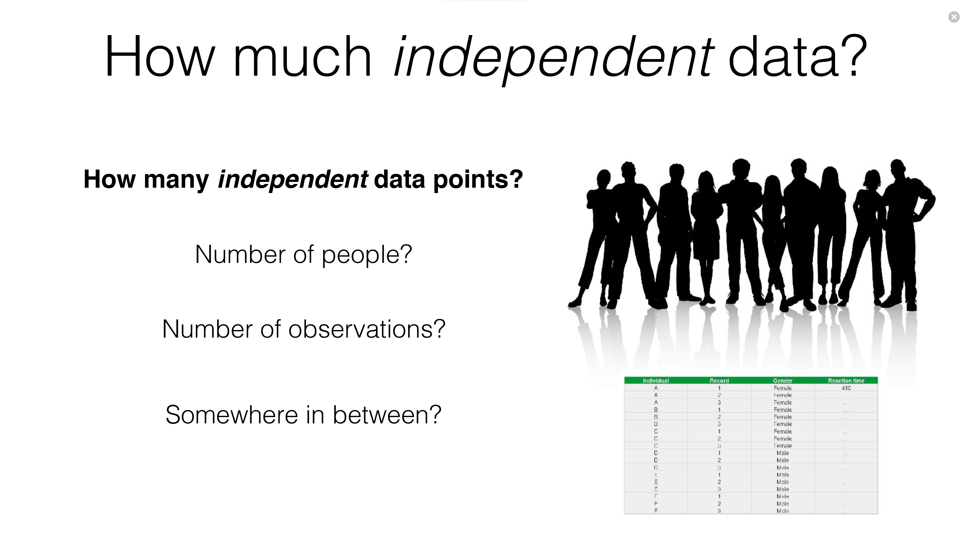

Slide 9
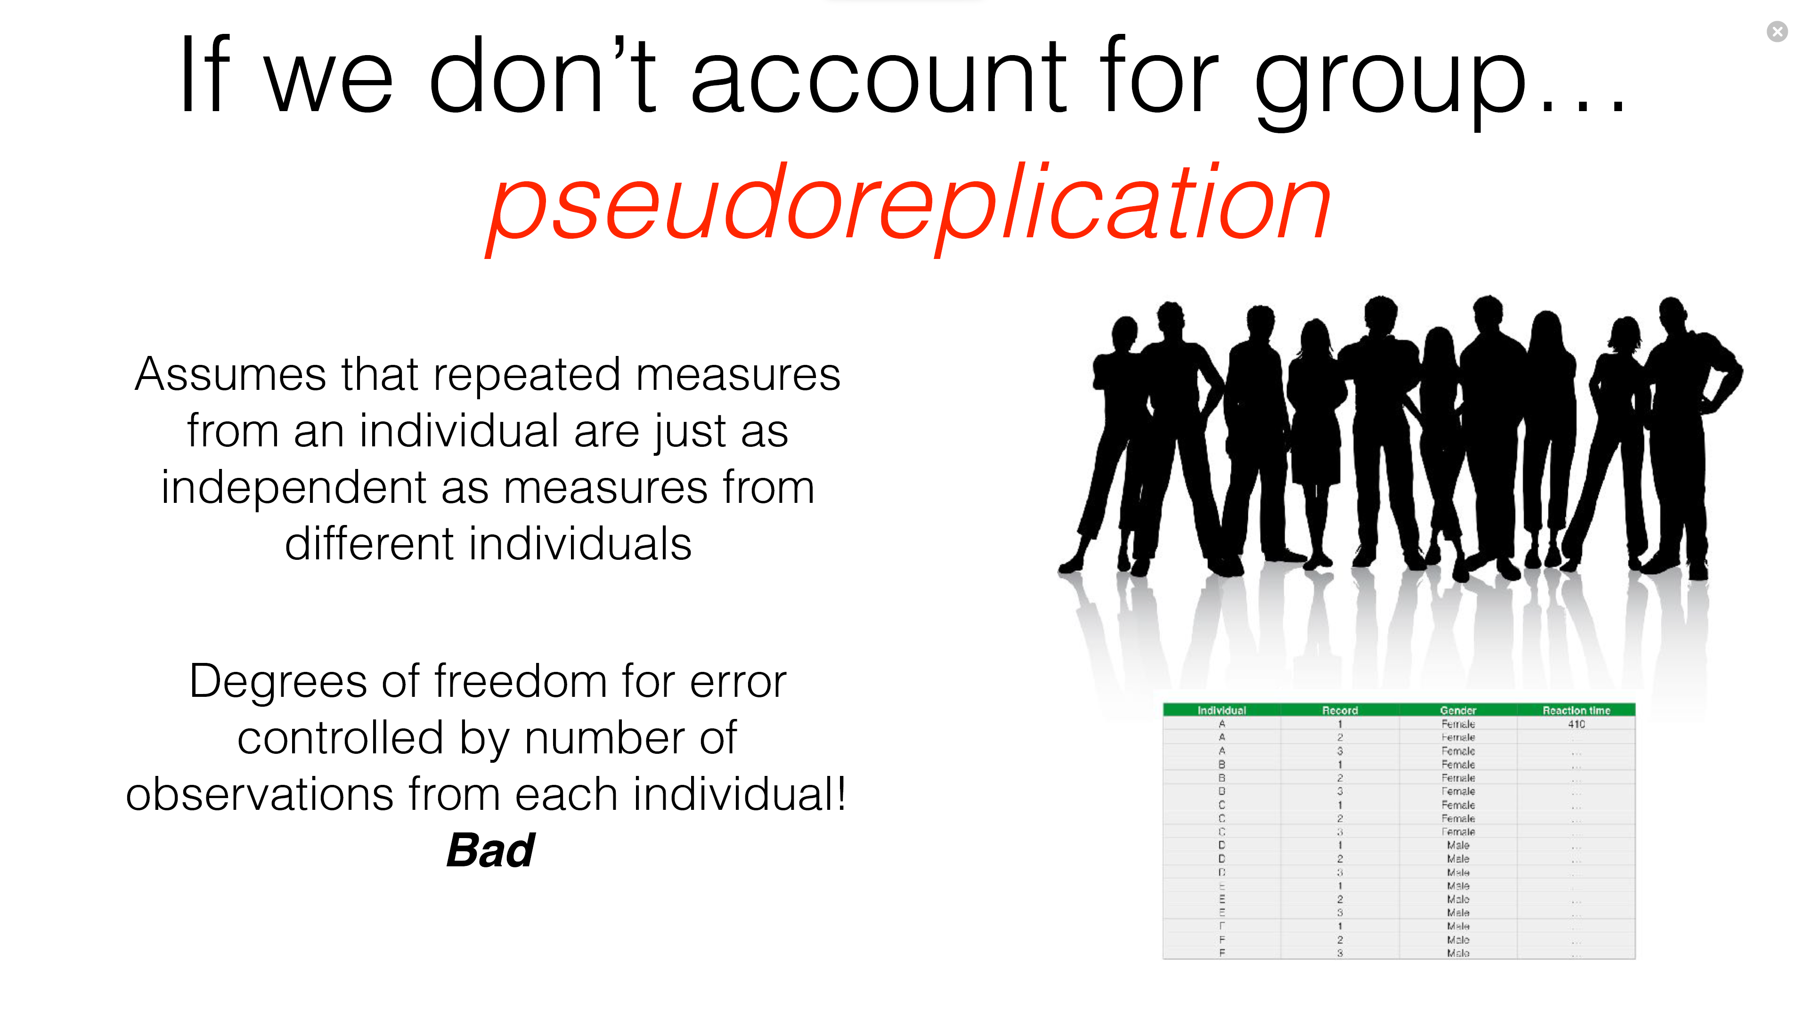
as in: ‘a natural cluster’
here the data are grouped by individual ID
Notes:
Observations on the same individual are more similar to each other than observations on different individuals

Slide 10
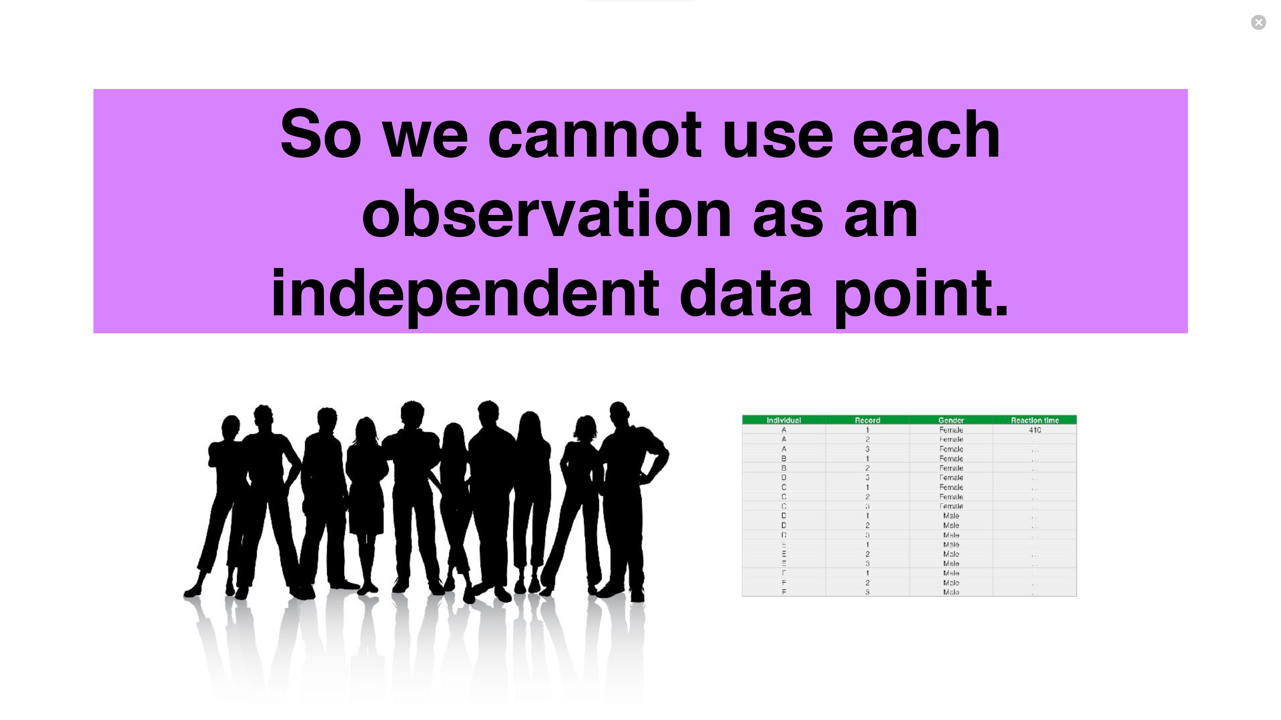
Observations on the same individual are more similar to each other than to observations on other individuals: any statistical model needs to account for this dependency!

Slide 11
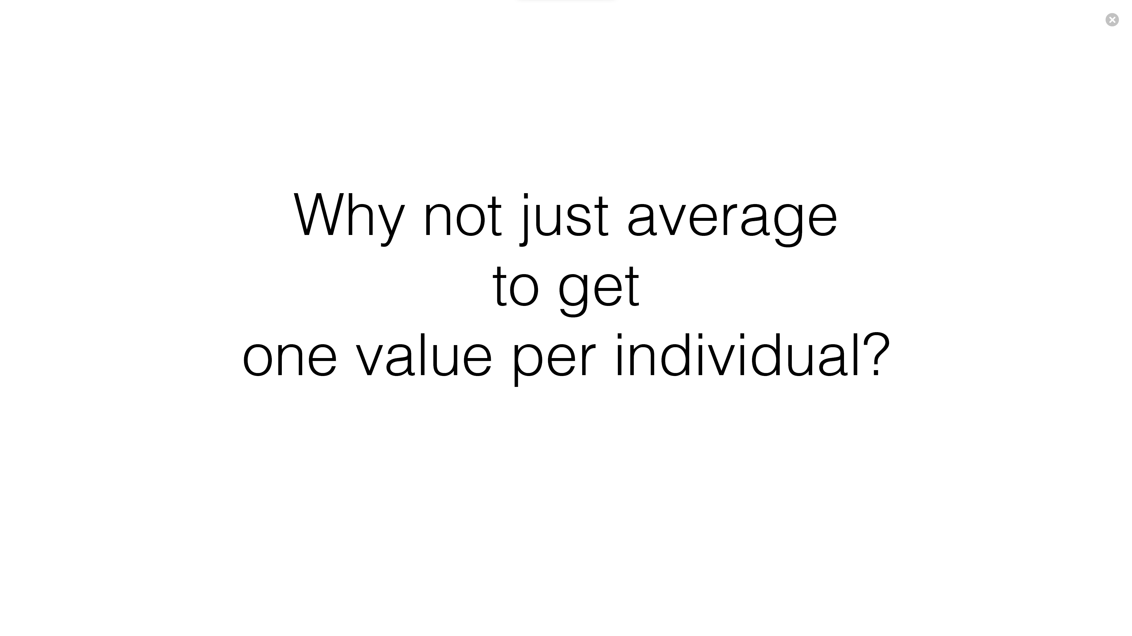
Notes:
You might say: what’s the fuss?

Slide 12
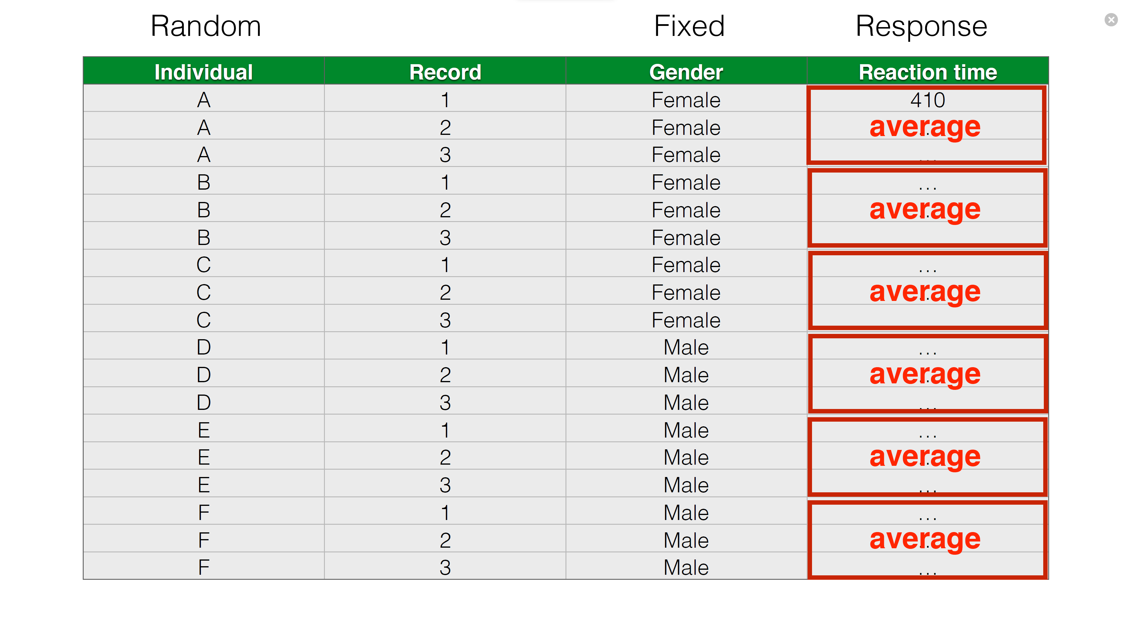

Slide 13
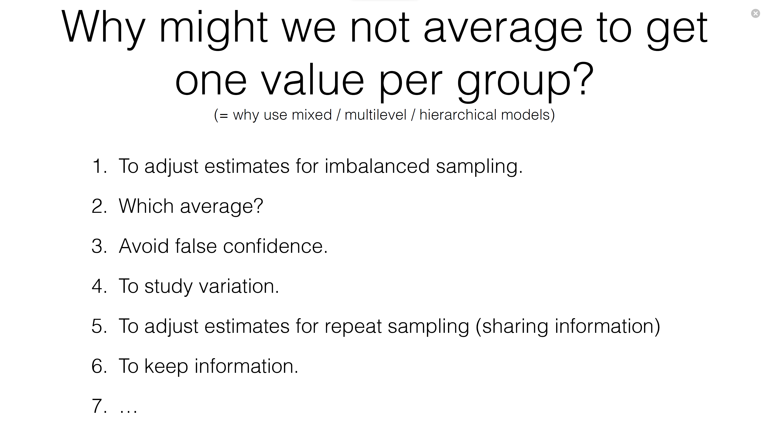
Notes:
Many reasons, some of these are highly related
Basically, you need to correctly represent the structure of your data in the model, and use all information collected

Slide 14
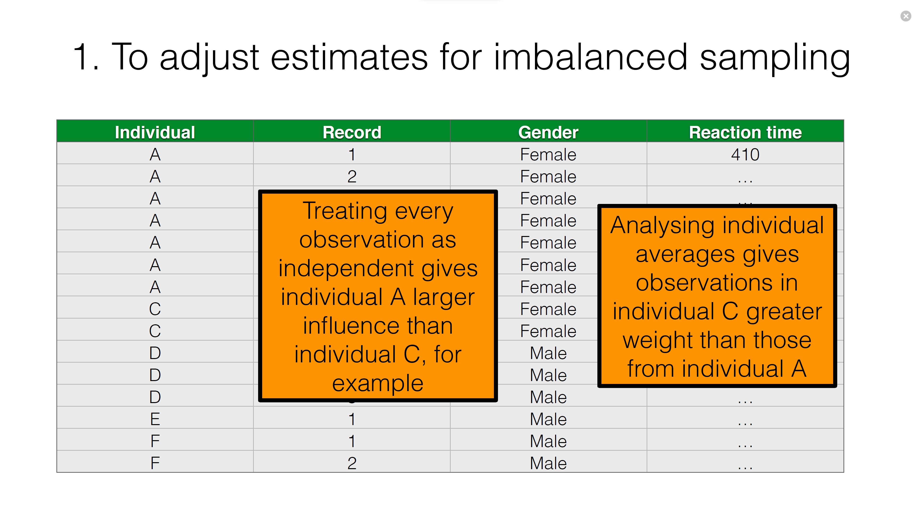

Slide 15
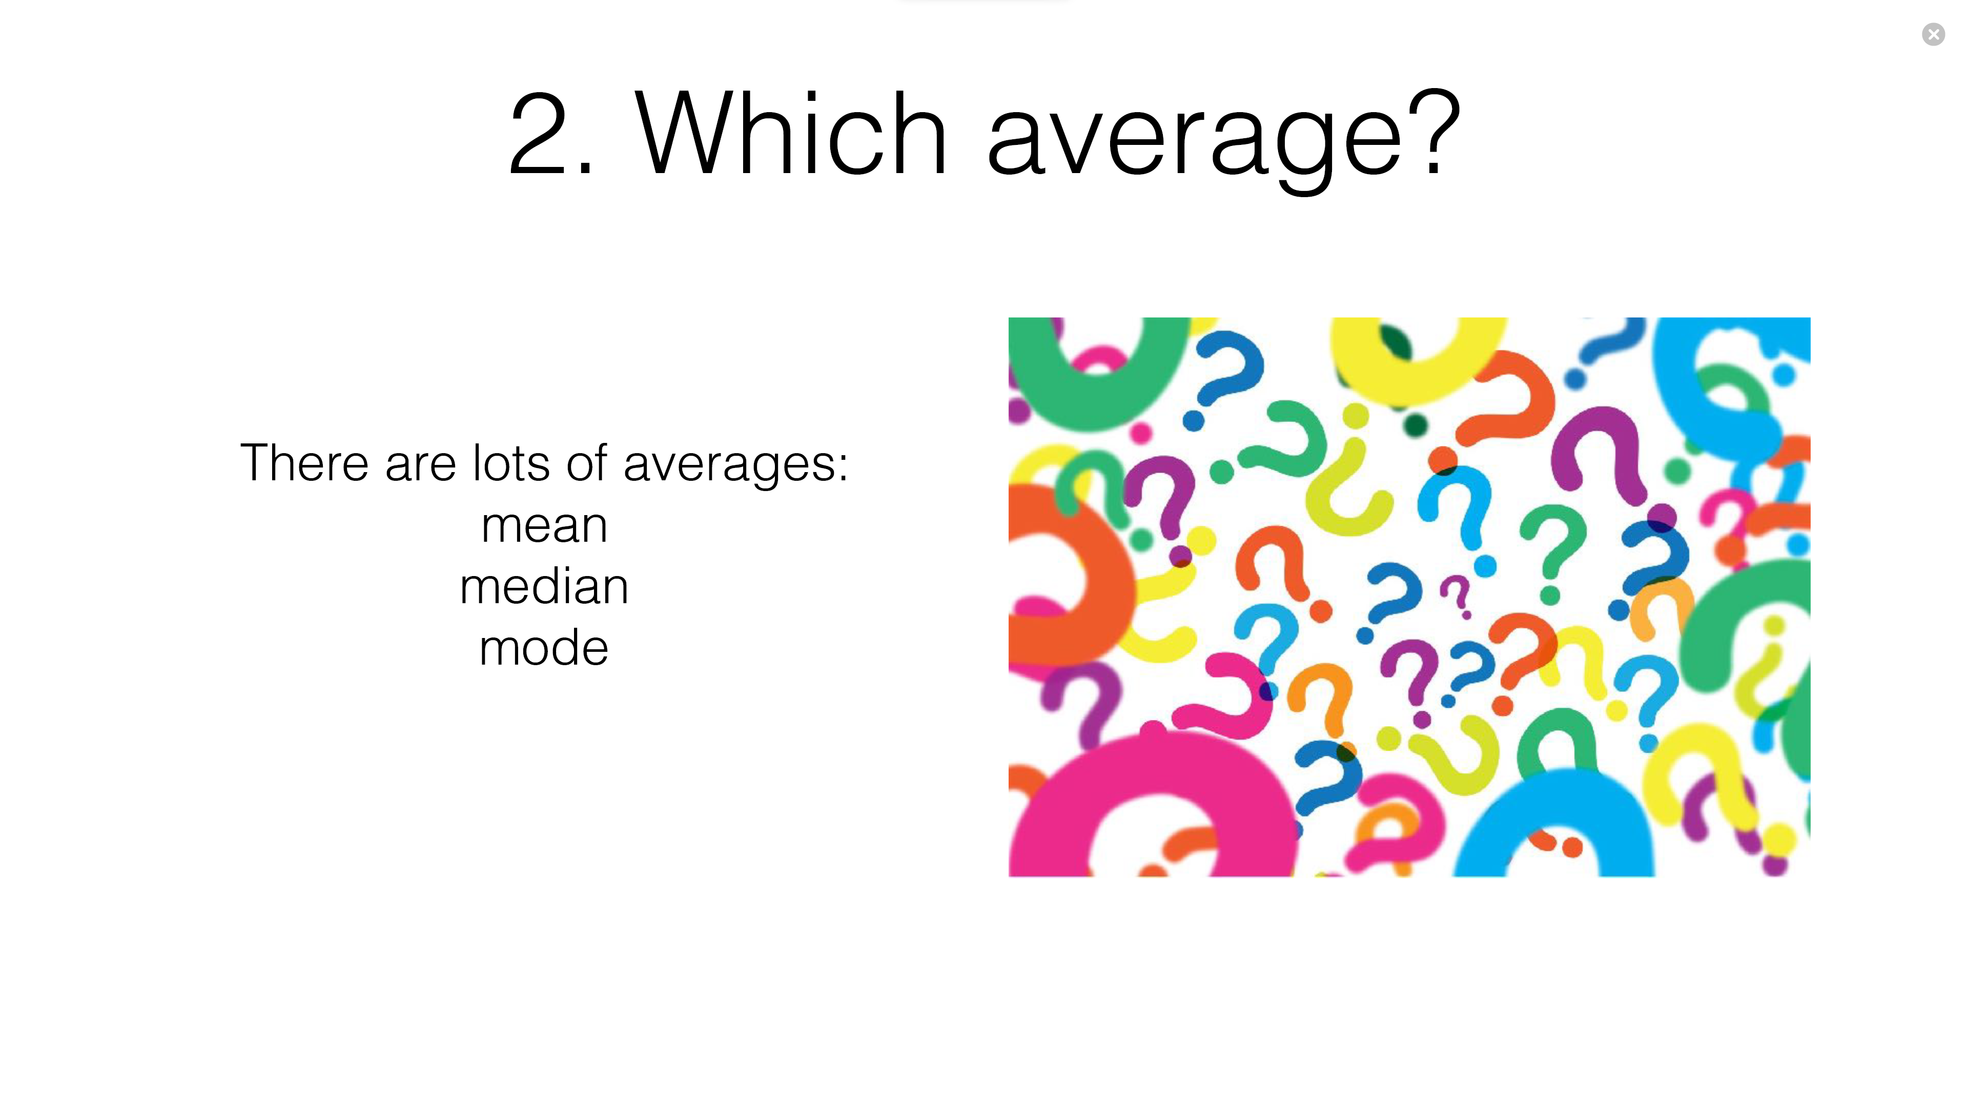

Slide 16
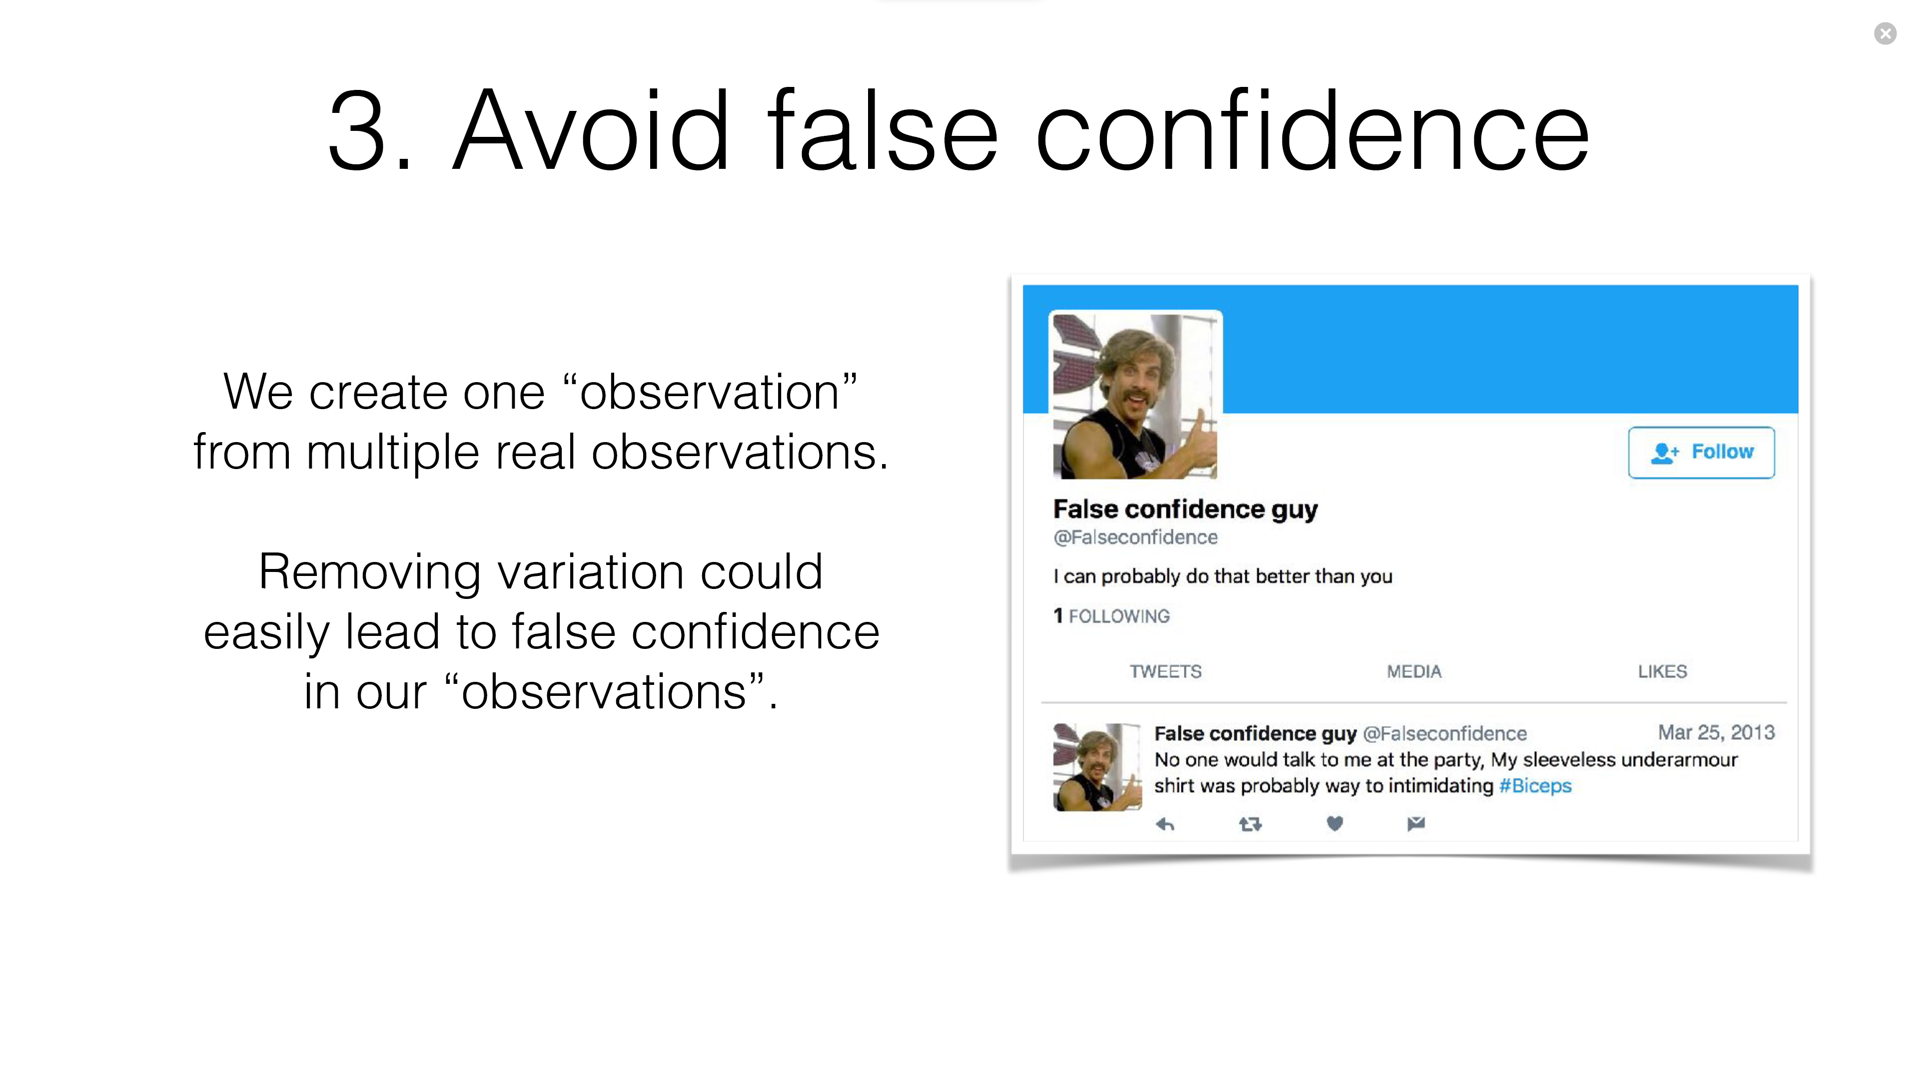

Slide 17
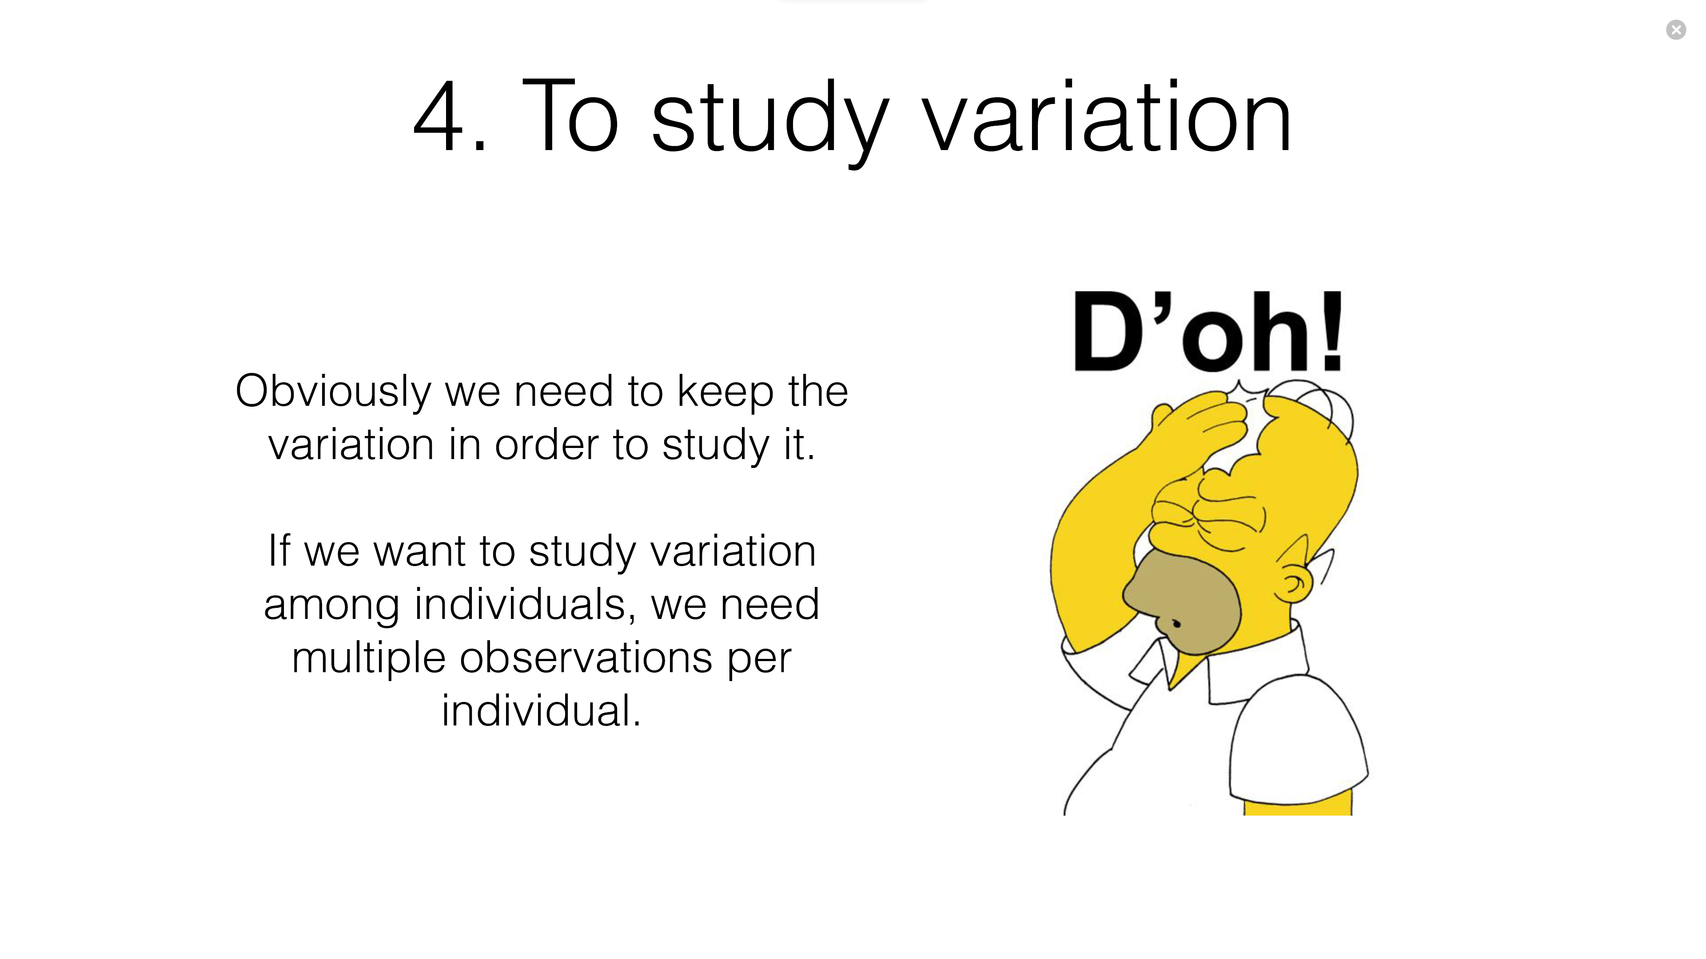
Notes:
There are two types of variation, and both might be interesting: between individual variation as well as within individual variation

Slide 18
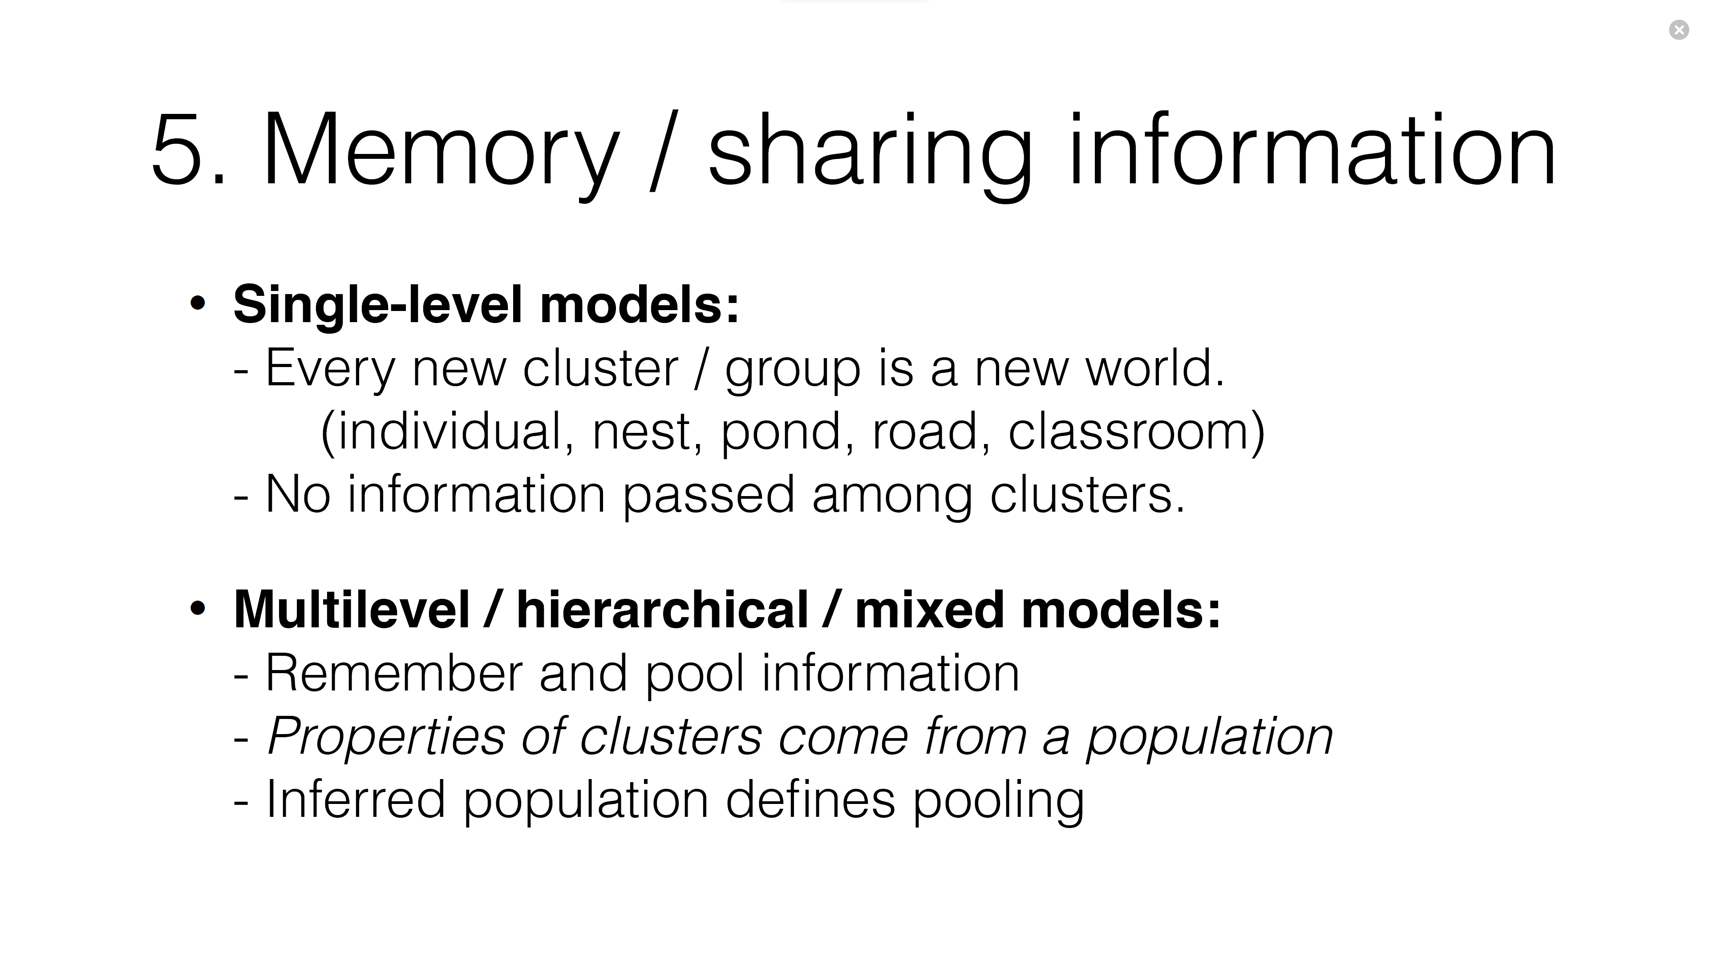
Notes:
A more efficient use of the total information content of the data: the model doesn’t have to “reinvent the wheel” over and over again for each individual

Slide 19
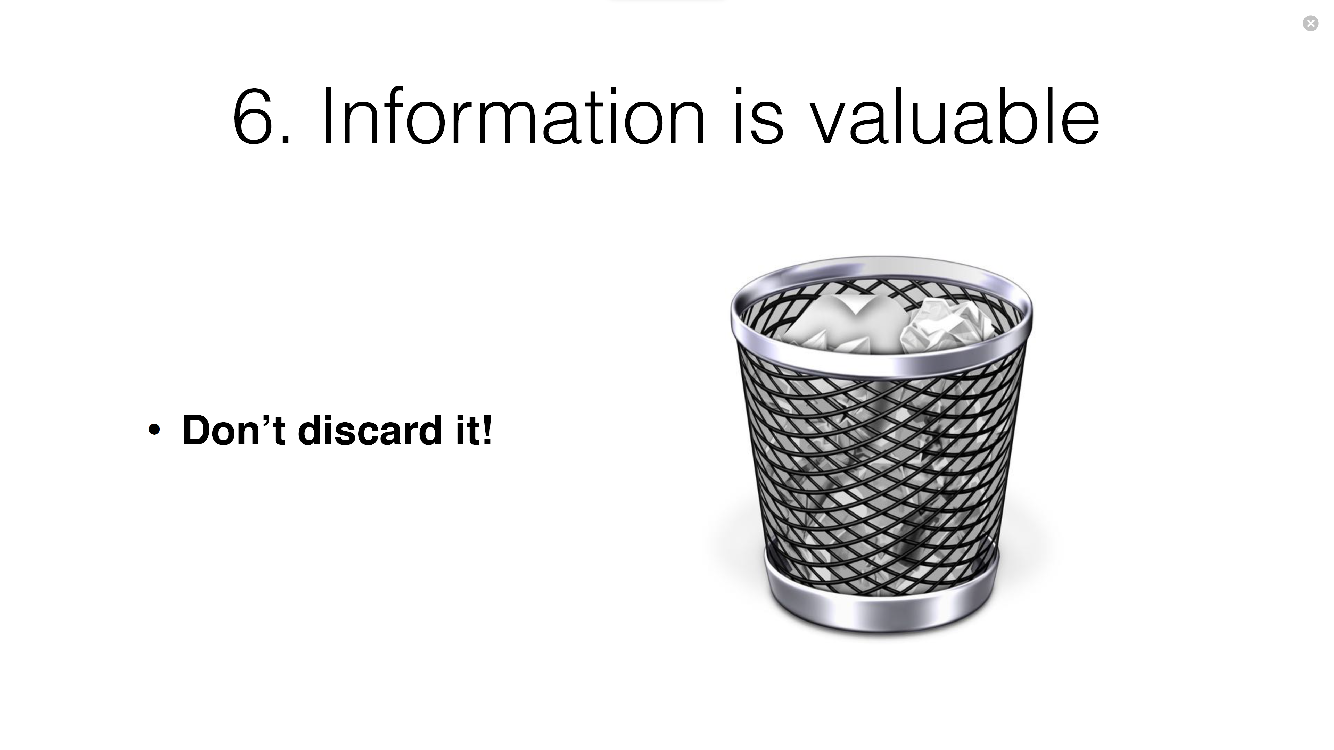

Slide 20
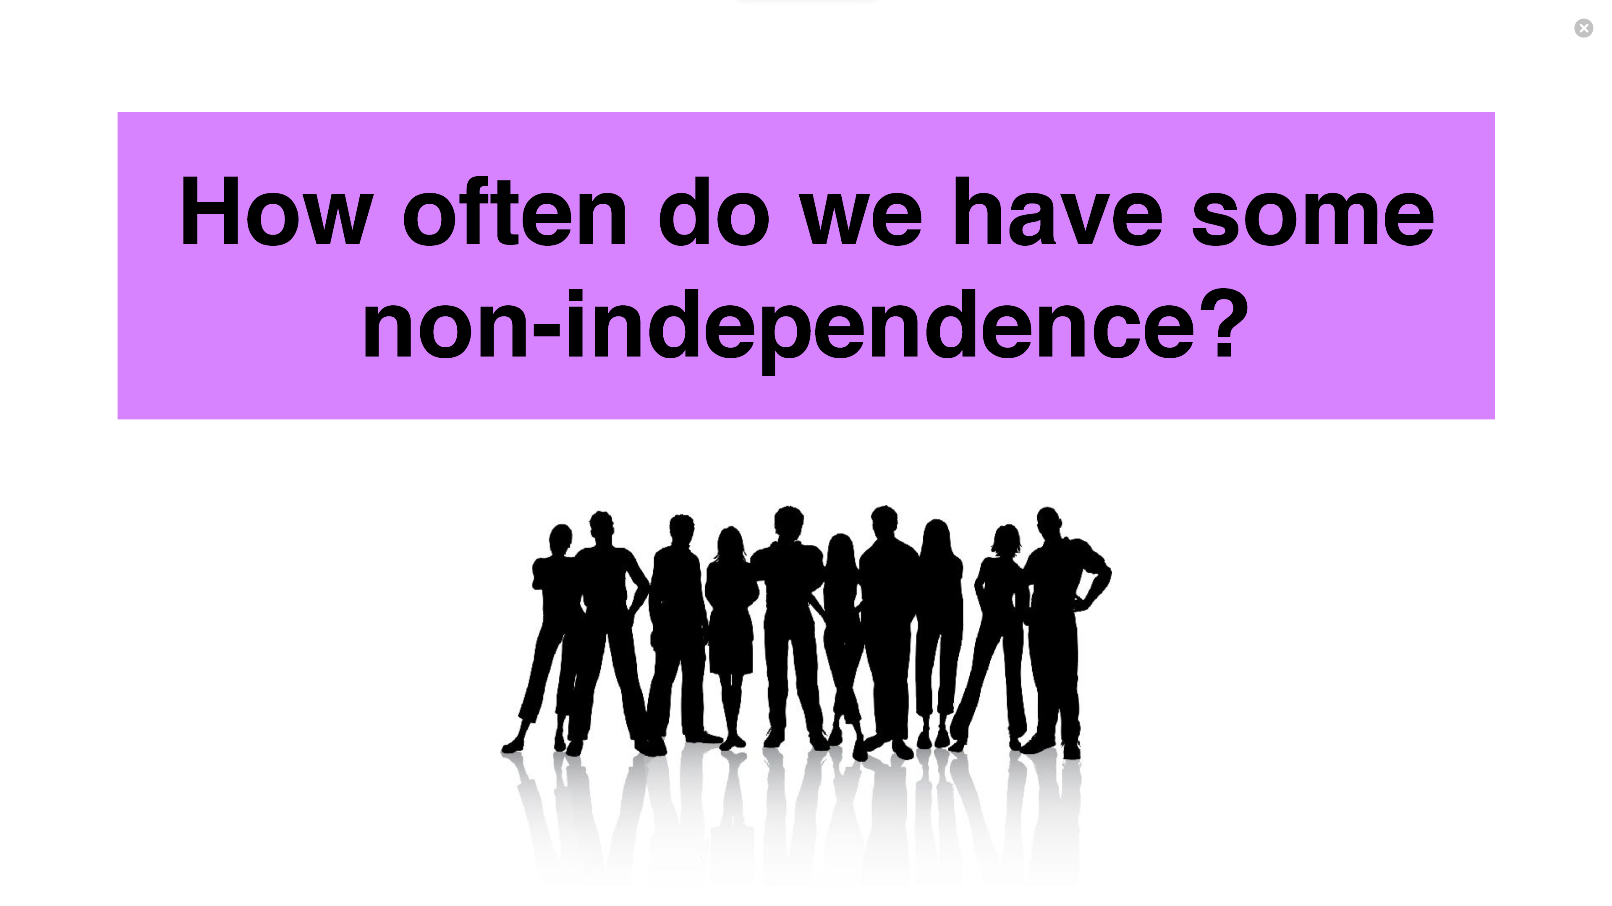

Slide 21
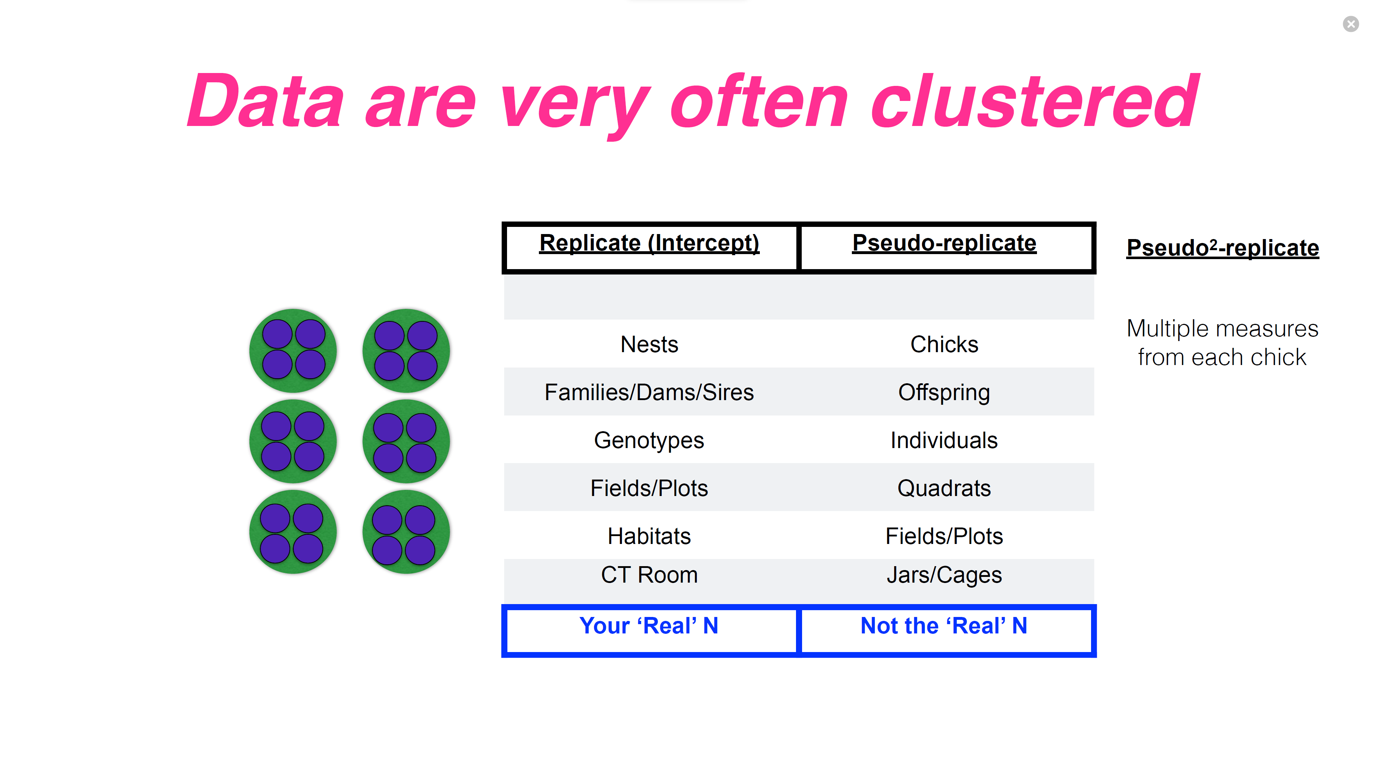

Slide 22
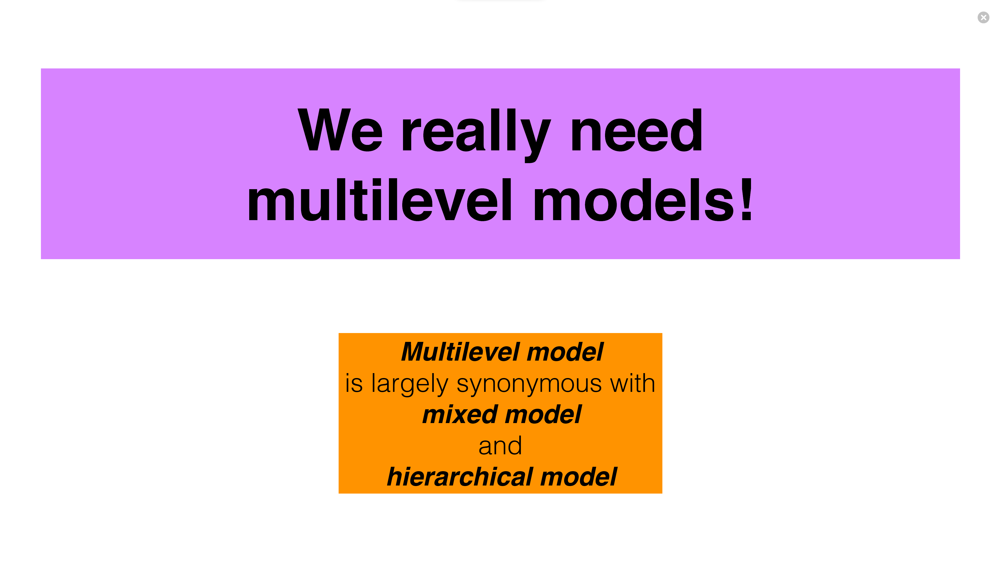
Also: repeated measures model

Slide 23
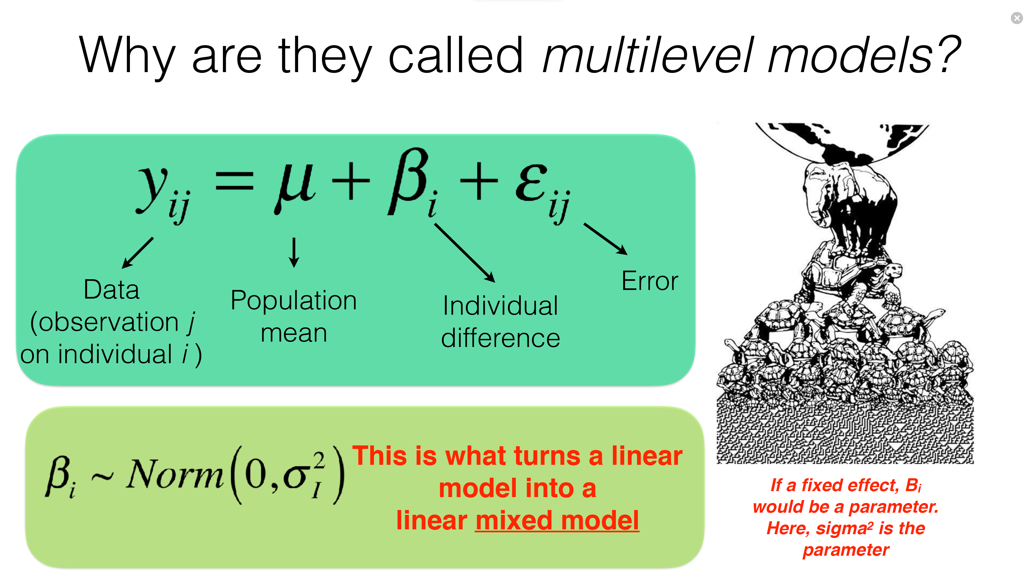
The population-level mean

Slide 24
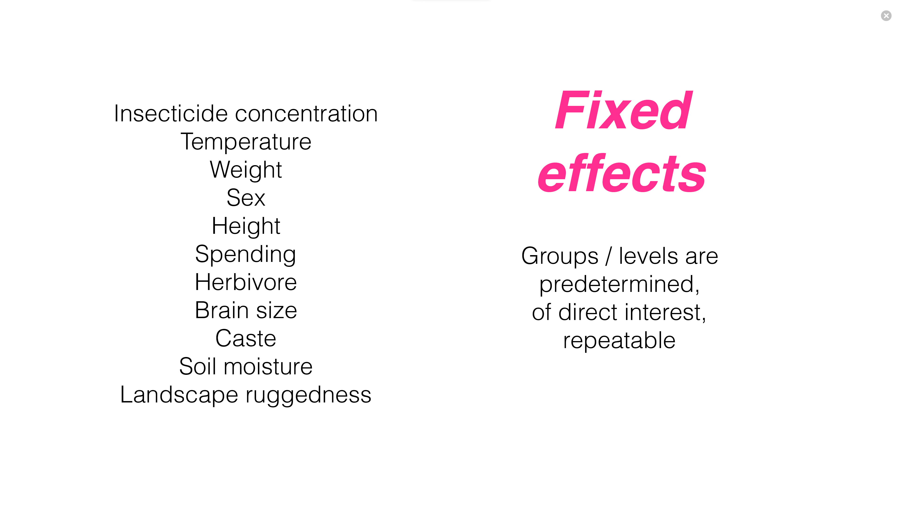
The independent variables (the “x-variables”)
Predictor variables
Explanatory variables

Slide 25
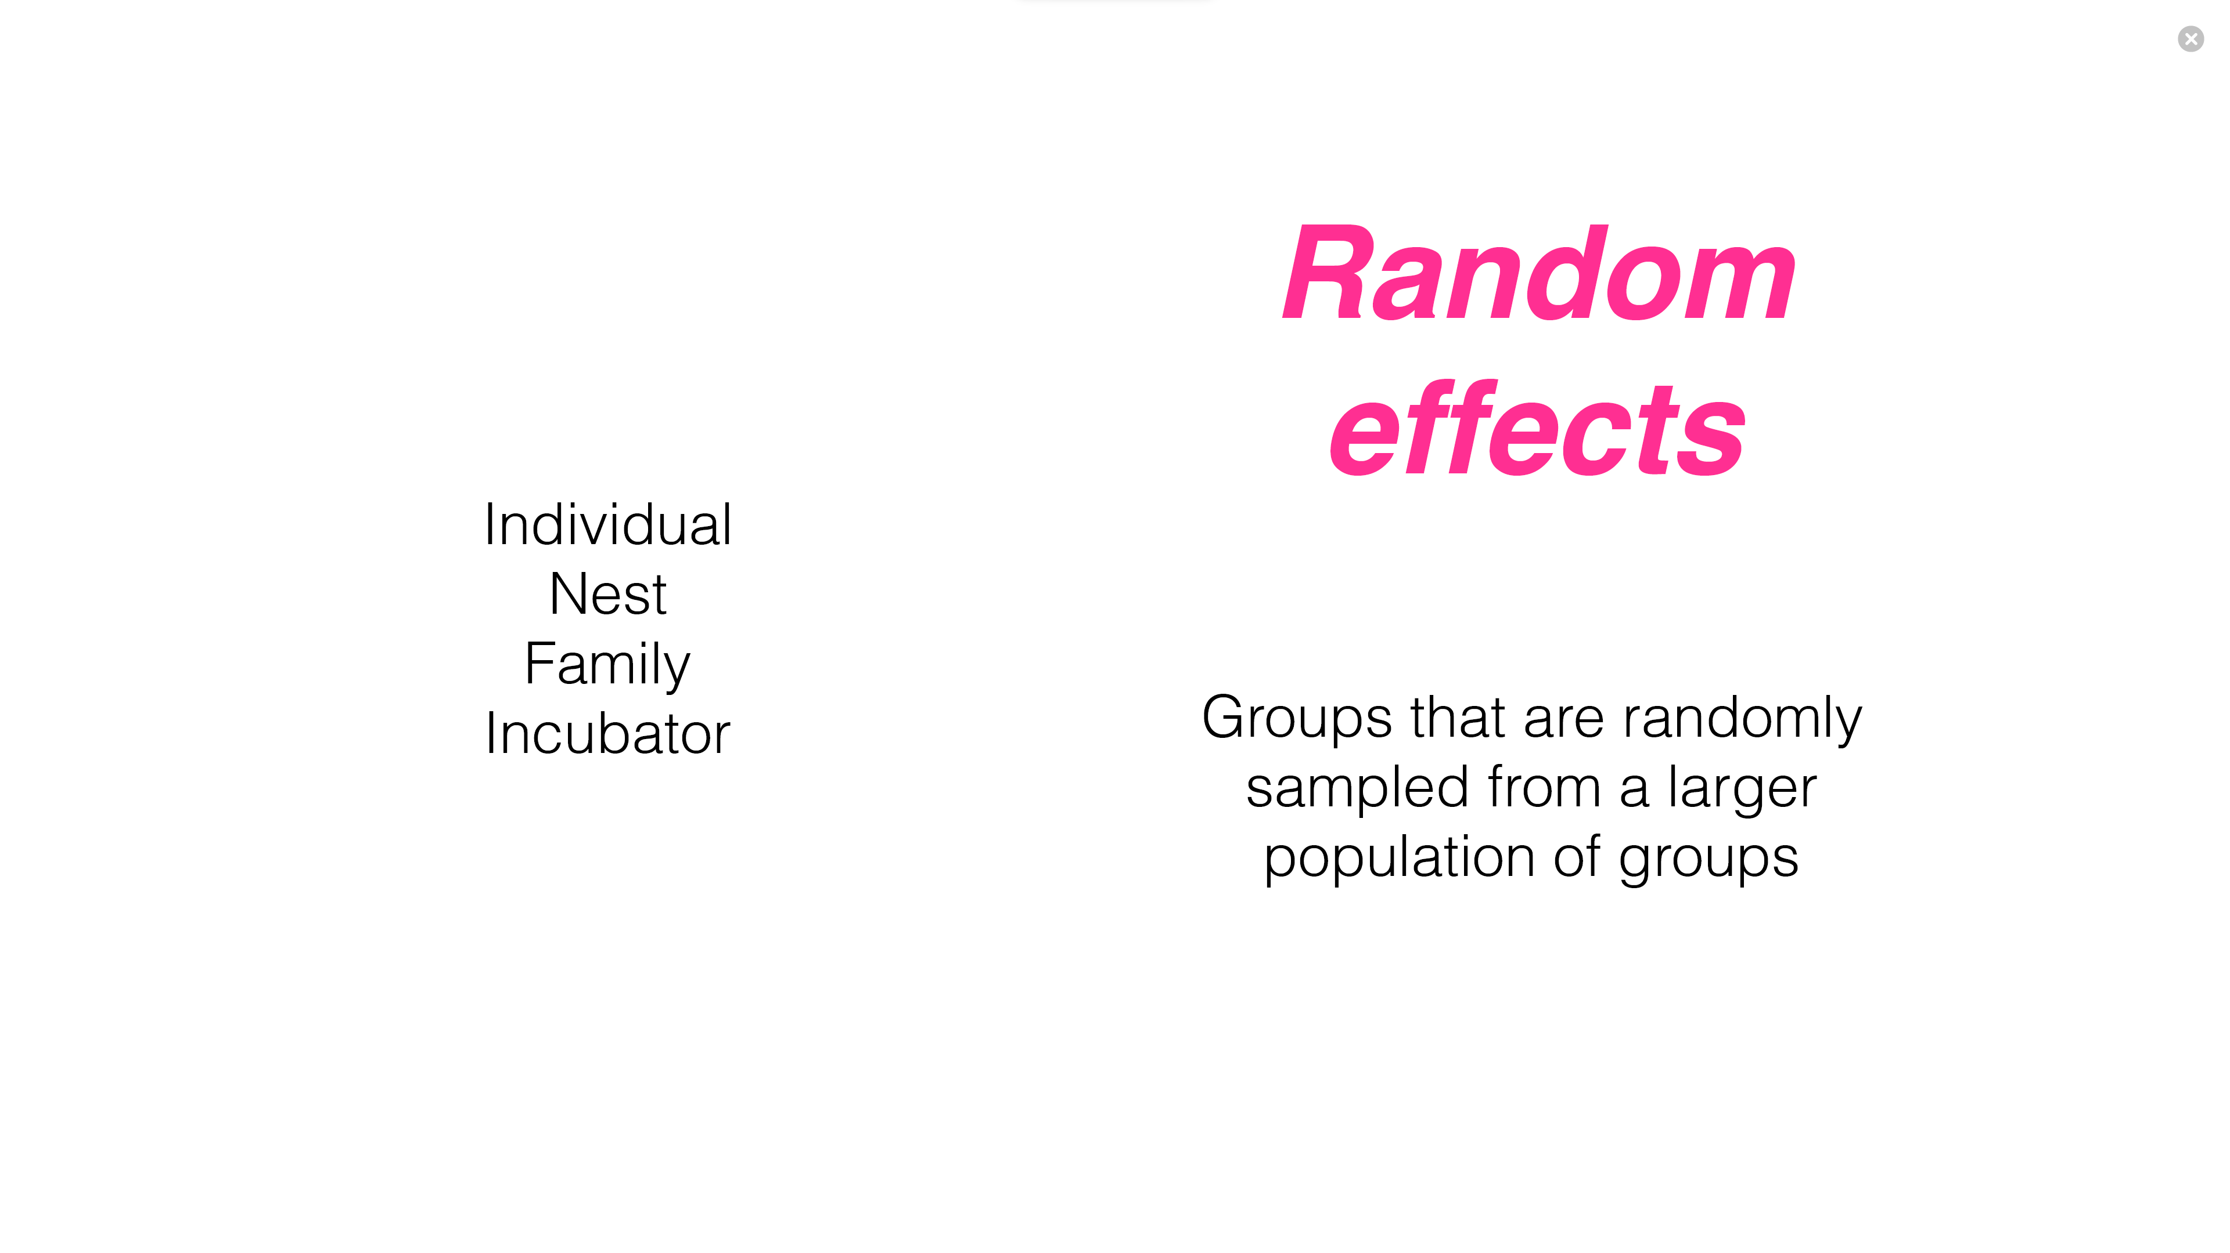
The natural clusters, or structure, of your data:
Spatial
Temporal
Social
…
Notes:
Mixed-effects models are called mixed-effects because they estimate both fixed and random effects!

Slide 26
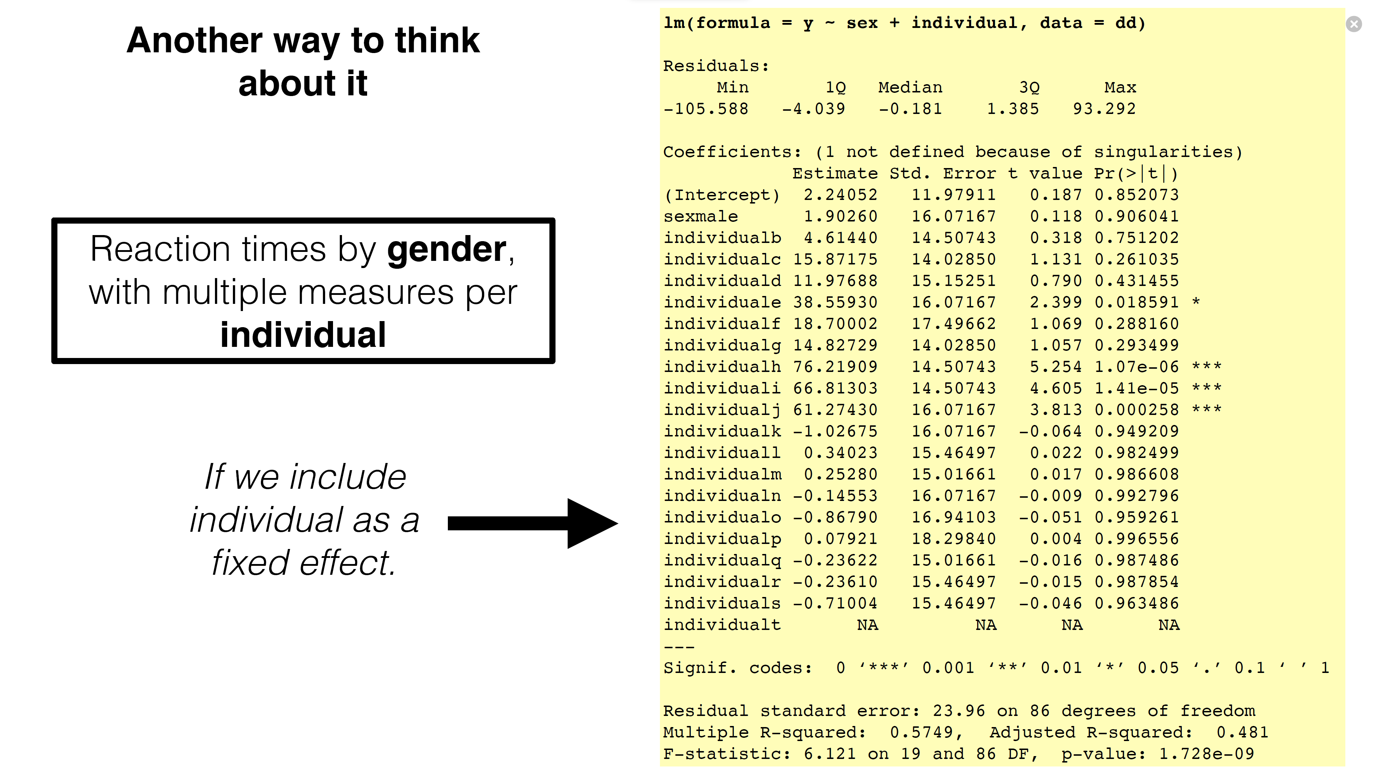
This approach is incorrect:
We treat each observation as independent
It is also redundant:
We are not interested in comparing each individual to a baseline individual (here: individuala)
Notes:
Individual t only contributed one datapoint -> cannot estimate a mean difference to individual a (the baseline)

Slide 27
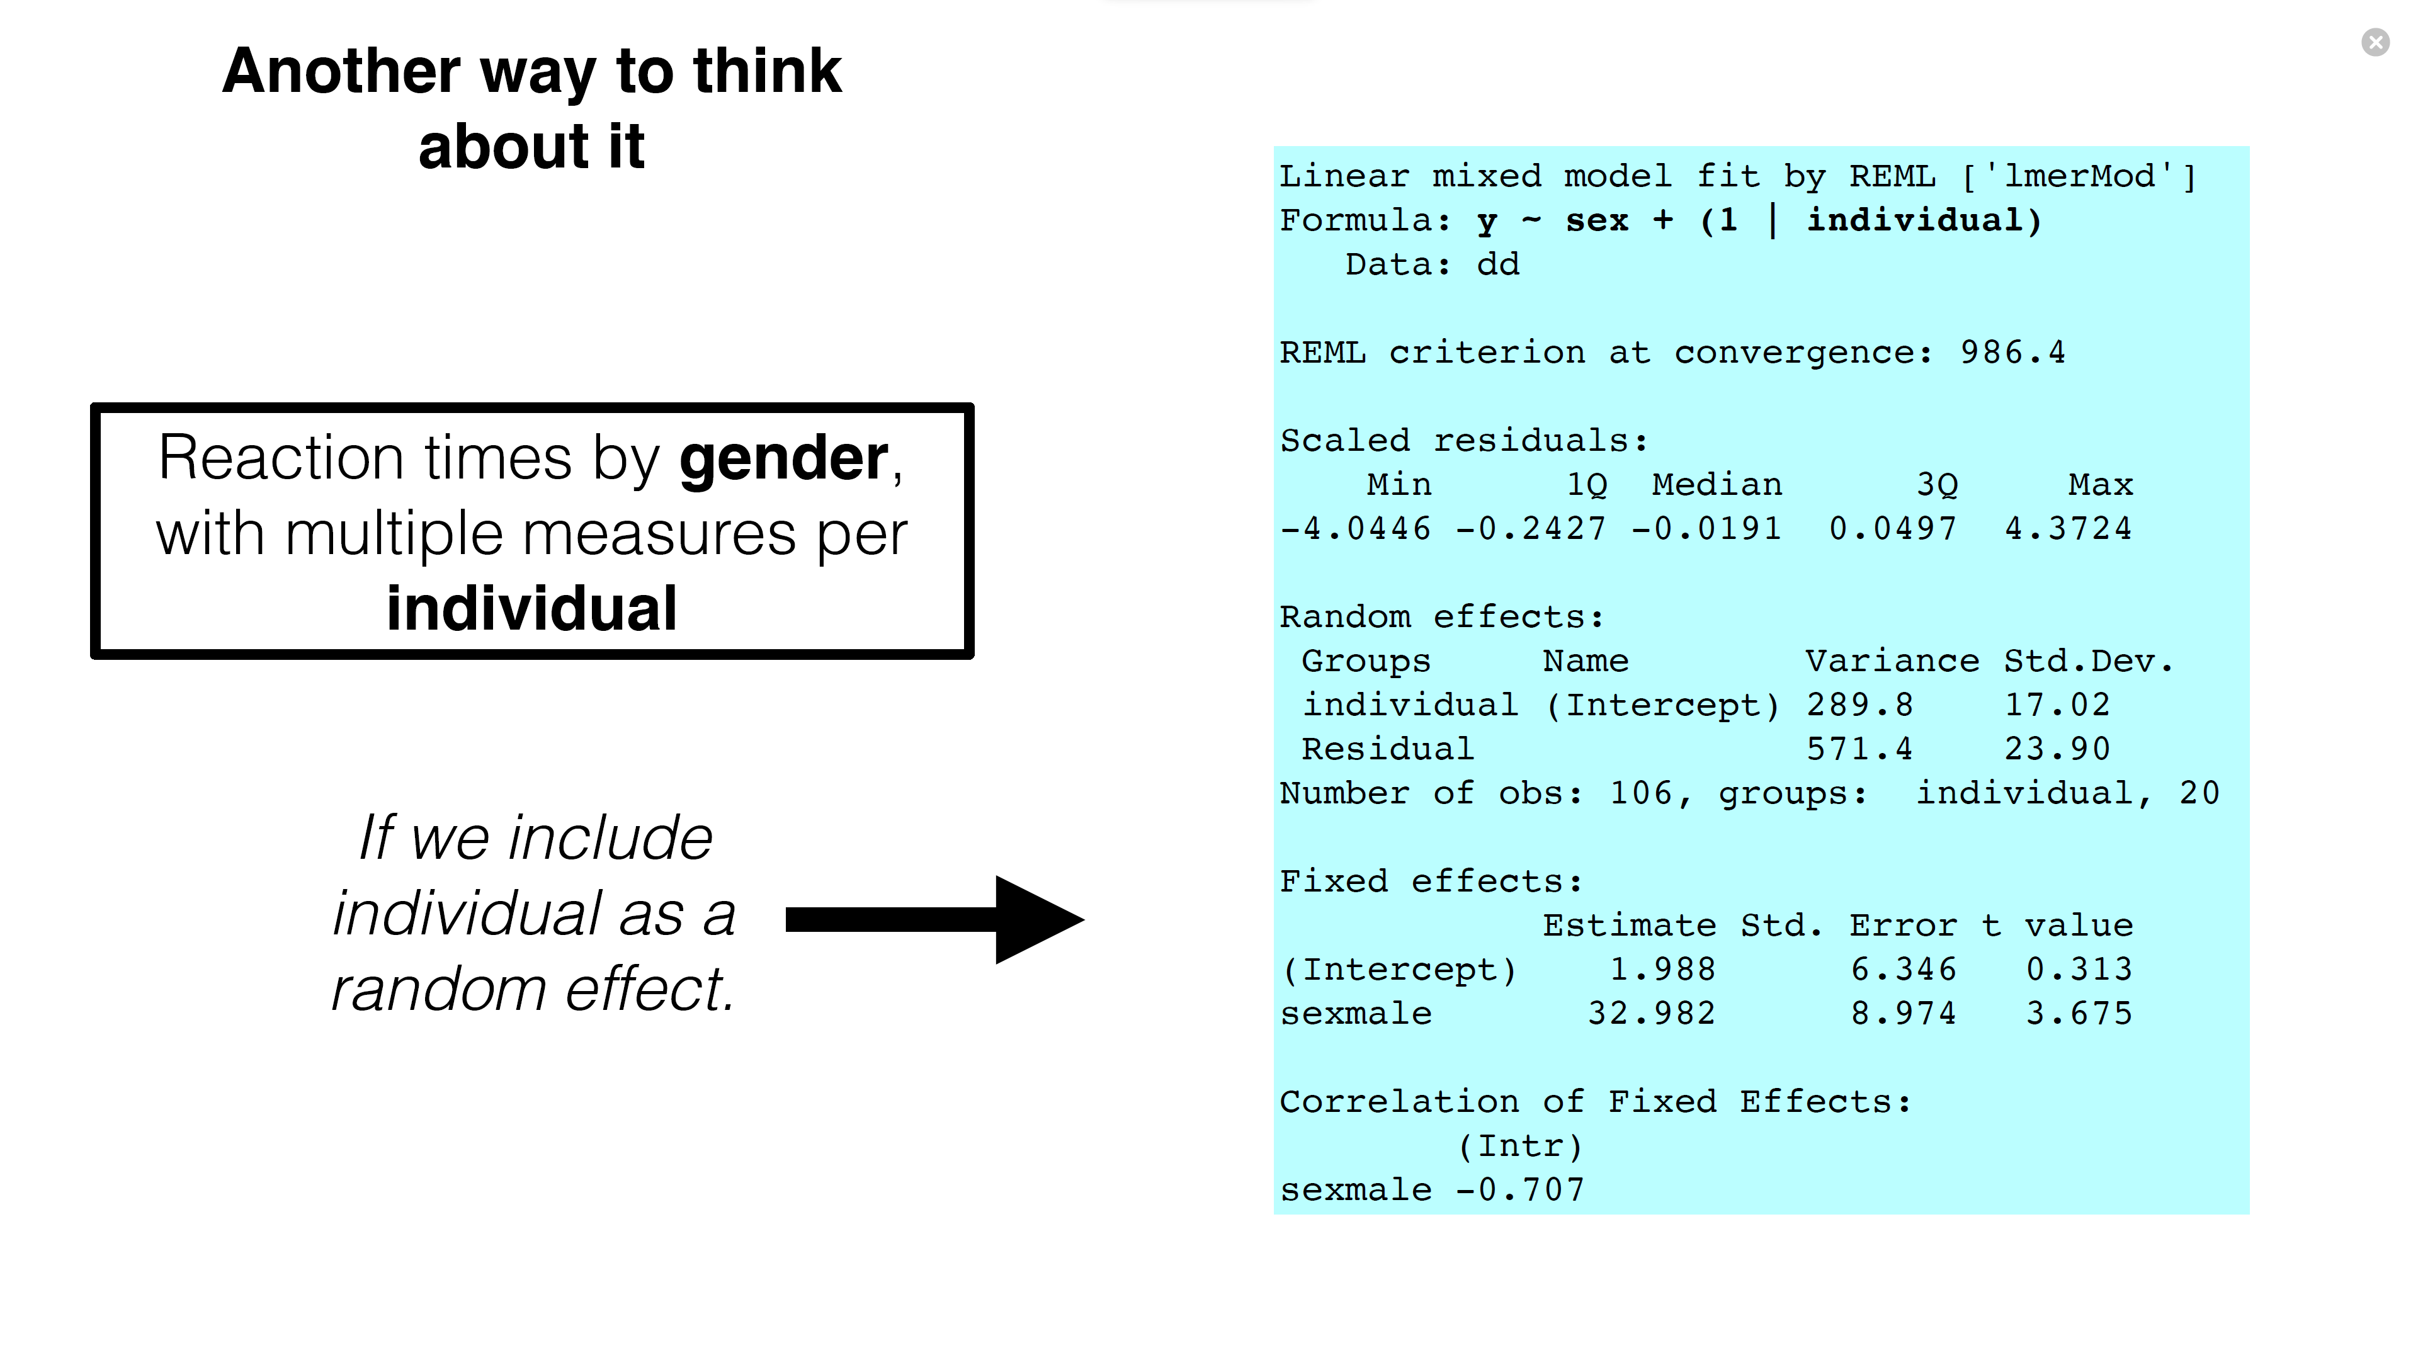
The variance component for individual ID:
quantifies differences in reaction time between individuals
It is the variance around the population mean
The familiar output:
The (population-level) intercept → mean reaction time for a typical female participant
The (population-level) effect of sex → the difference in reaction time between a typical male and female participant
Notes:
Variance component captures differences between individuals, i.e. the variance around the population mean
(1|individual) -> the intercept (i.e. the mean reaction time) varies per individual; each individual has it’s own mean reaction time, it’s own random intercept
Note: by default we may not get a p-value, that’s because the correct number of degrees of freedom is not known!

Slide 28
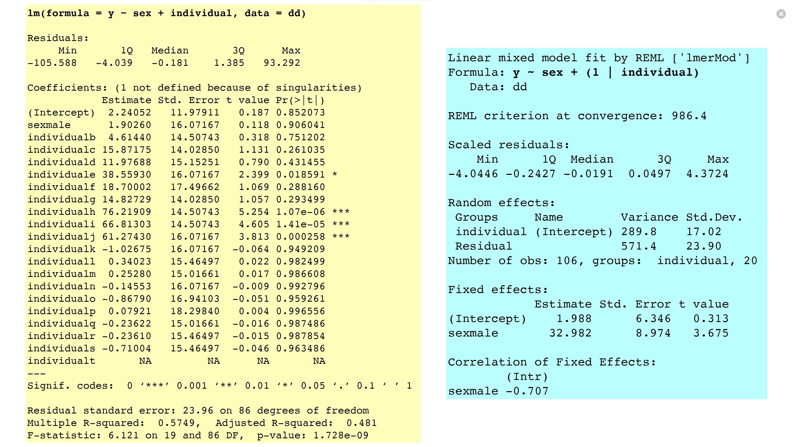

Slide 29
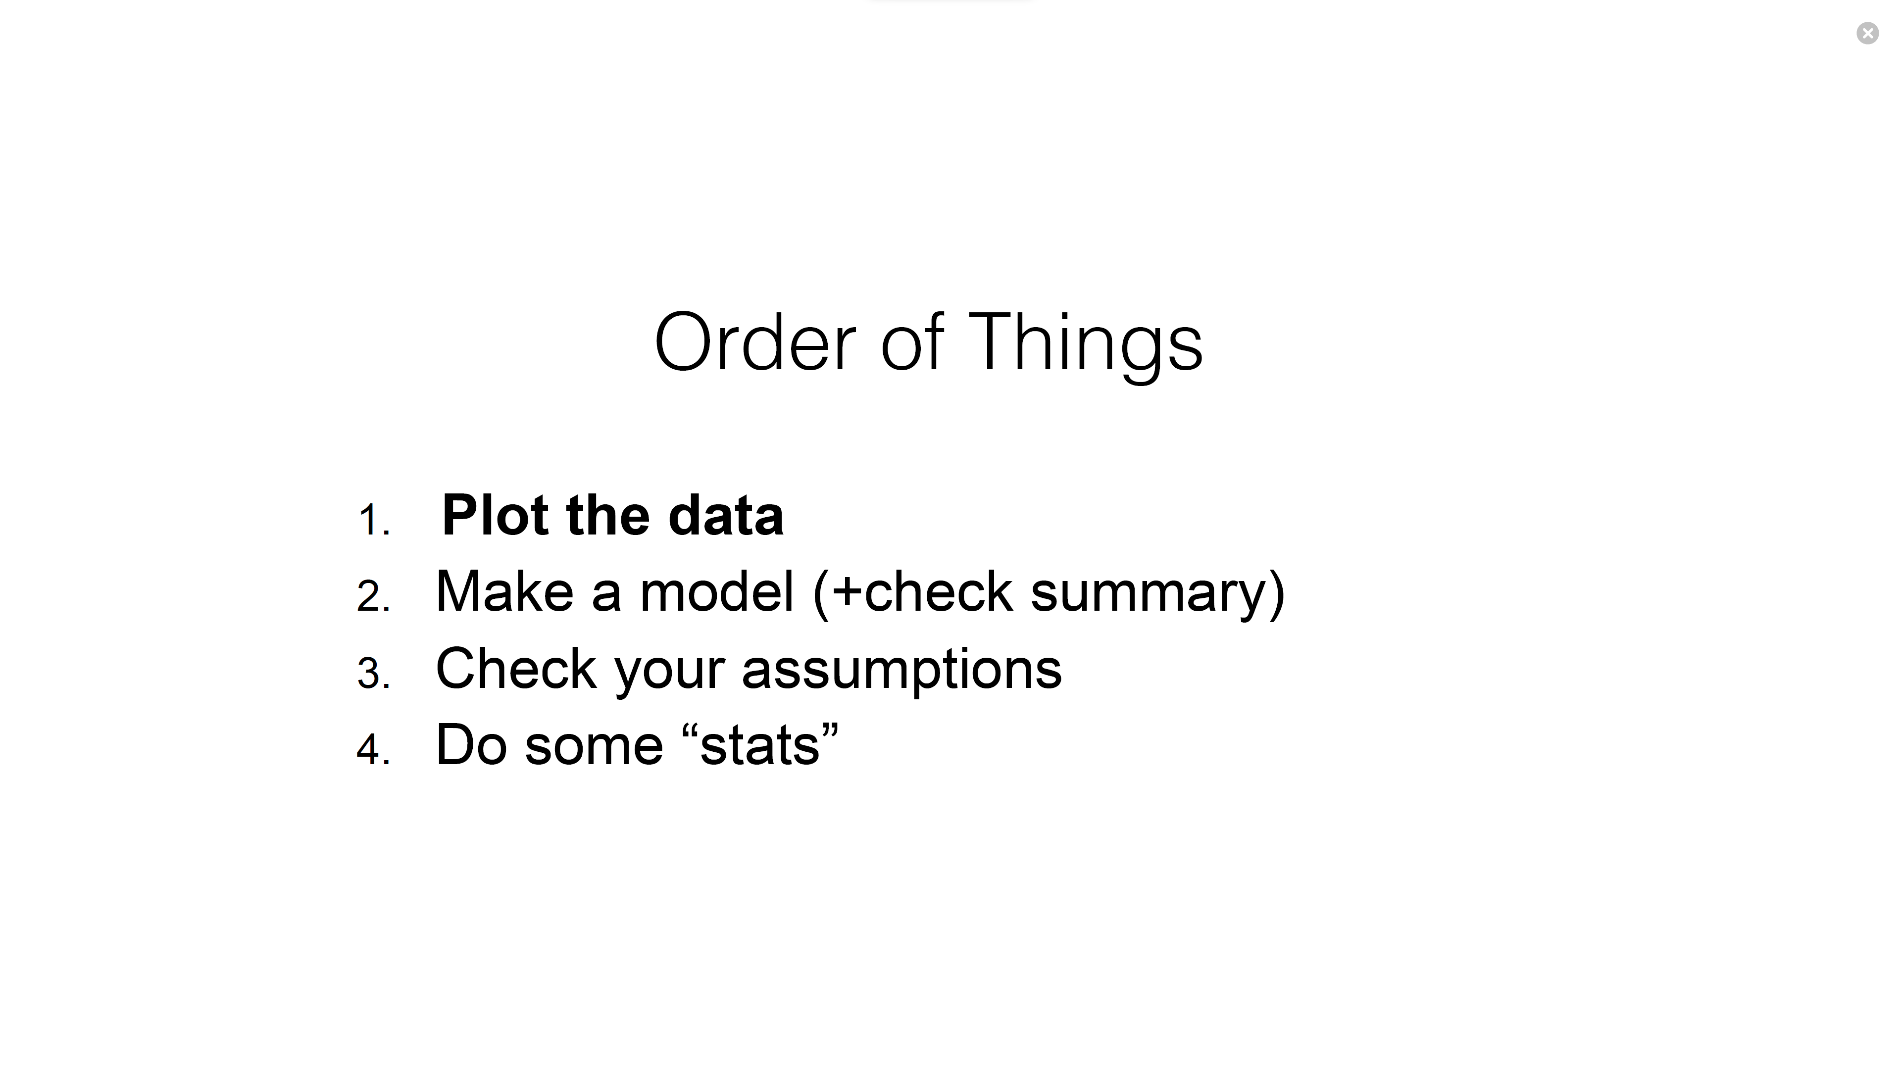

Slide 30
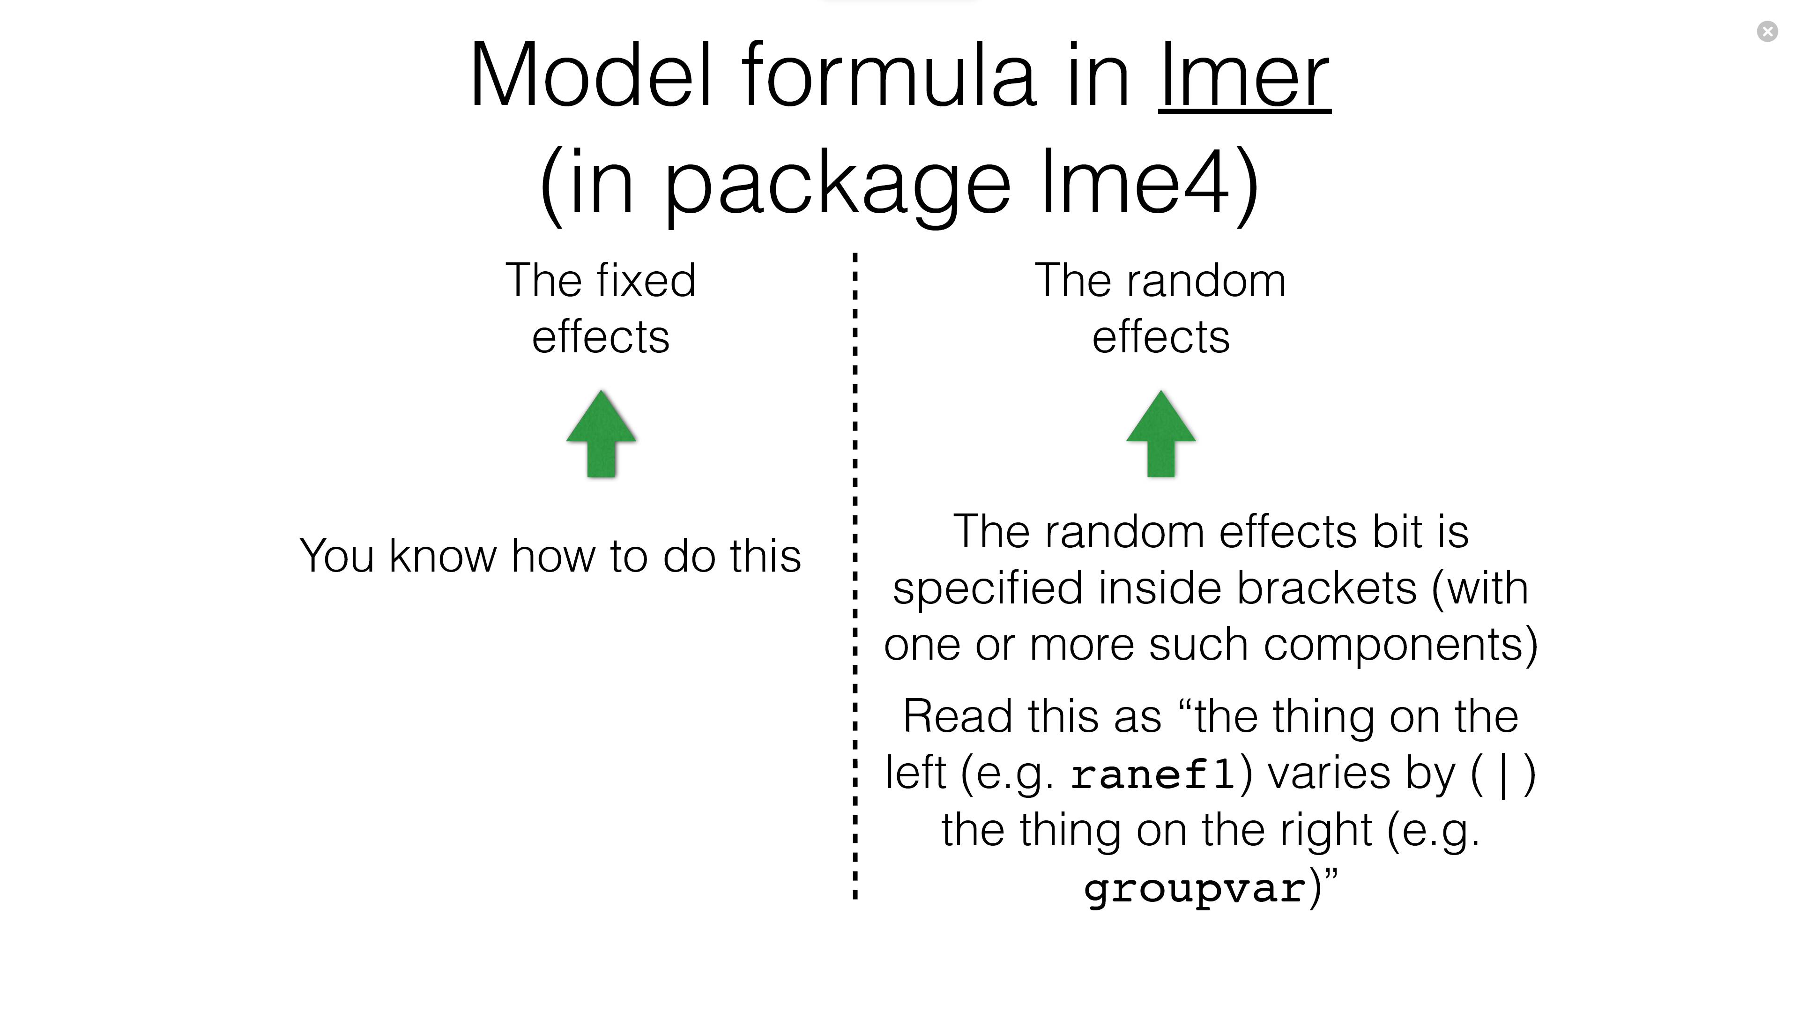

Slide 31
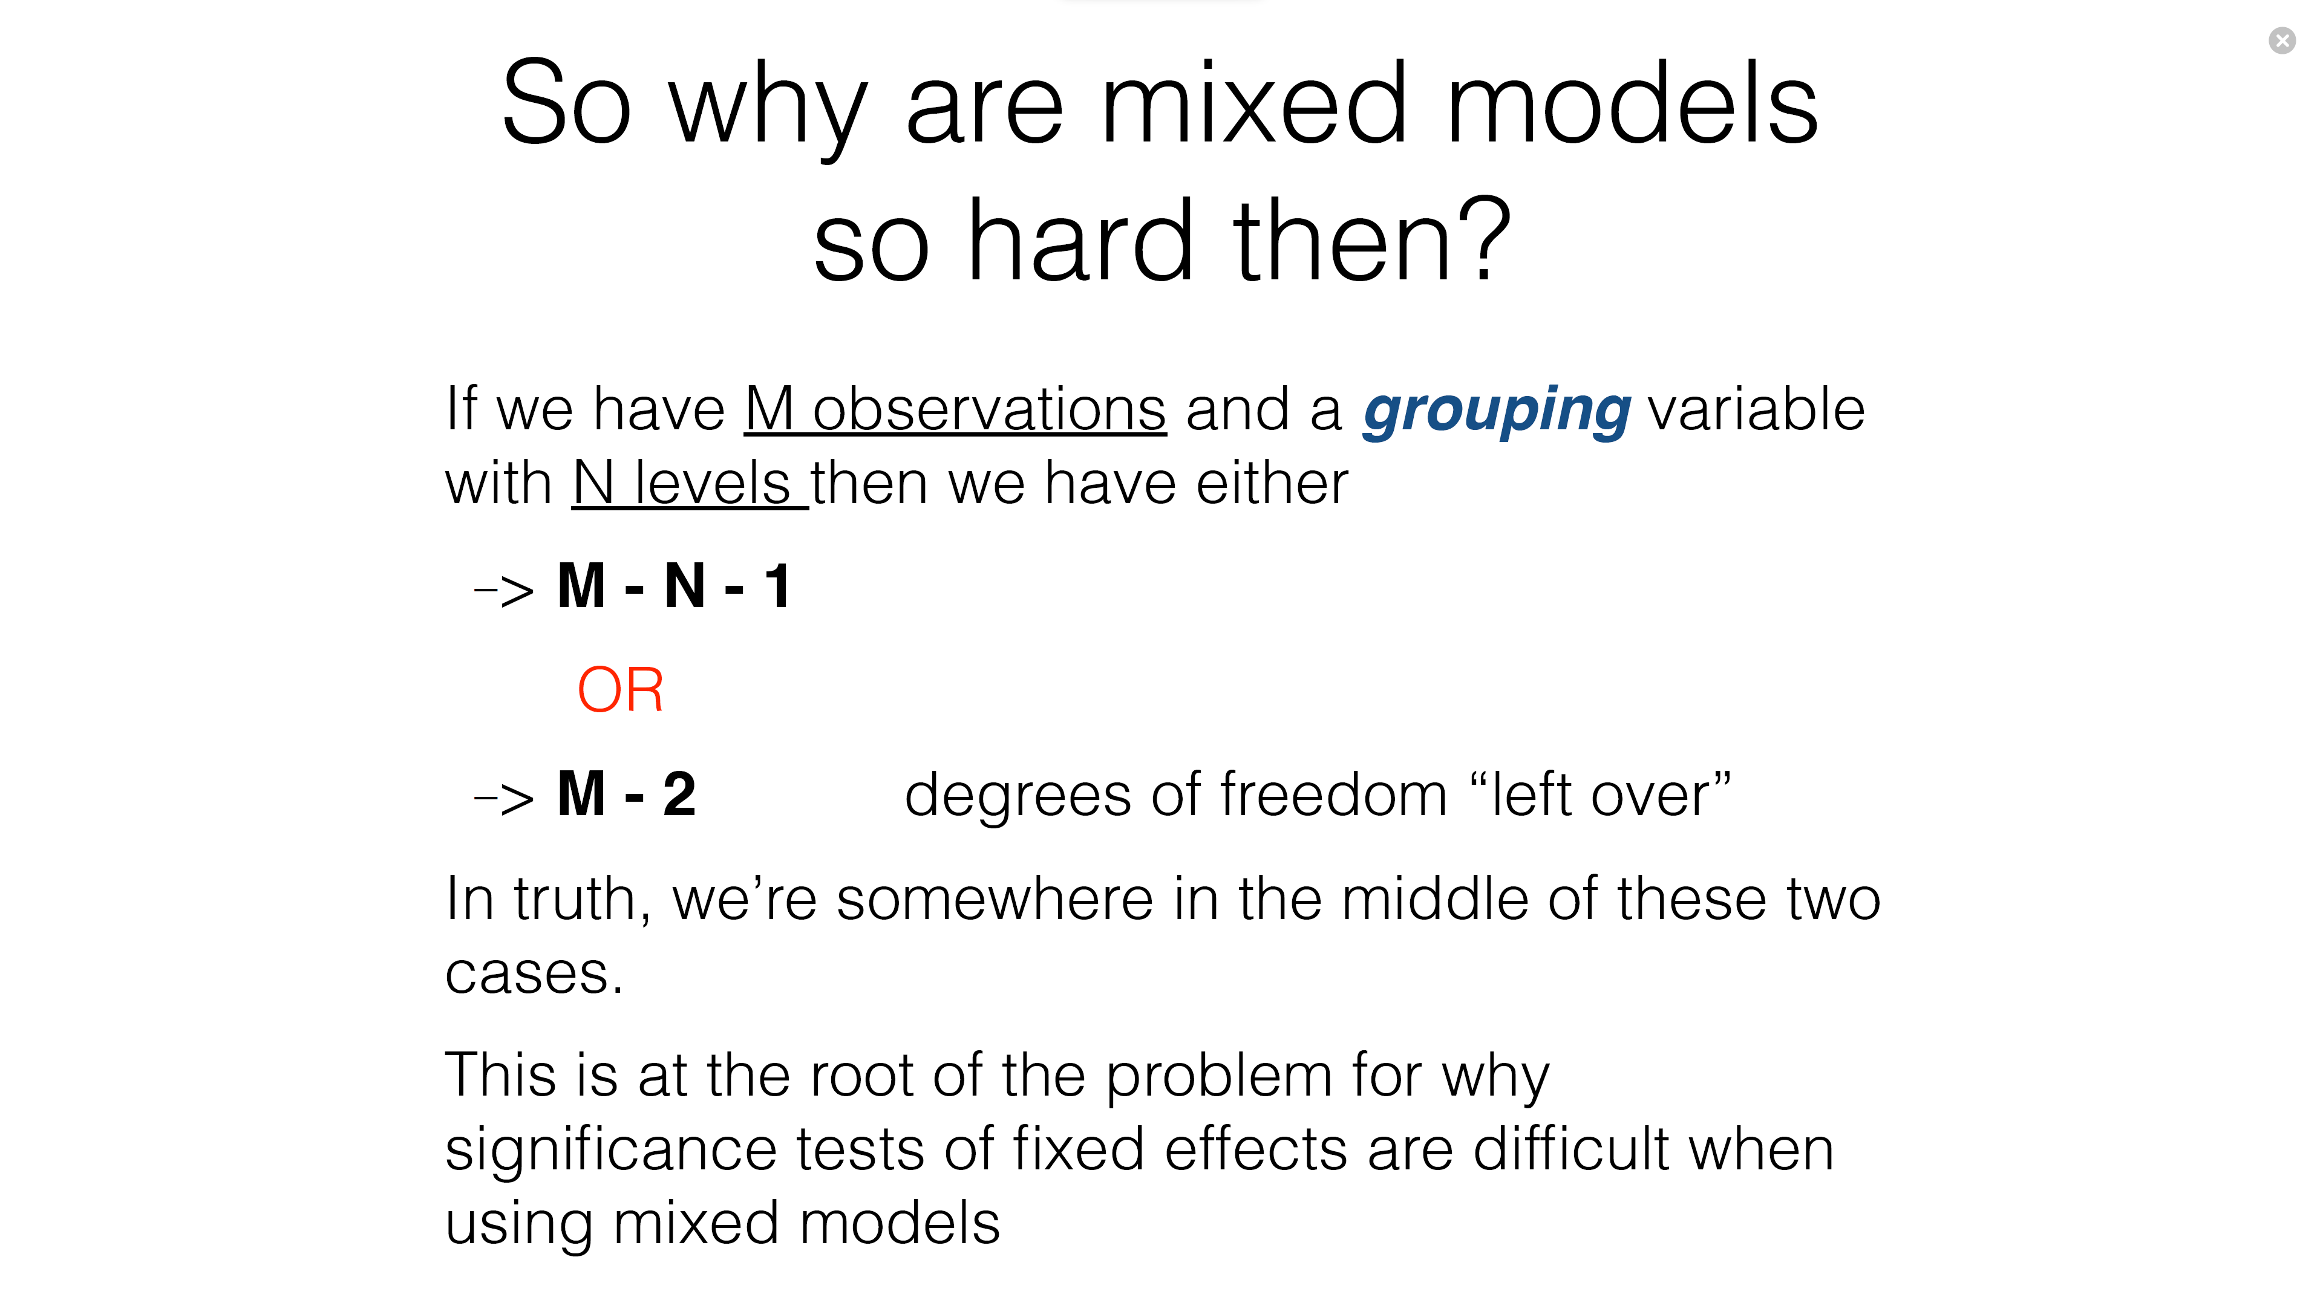

Slide 32
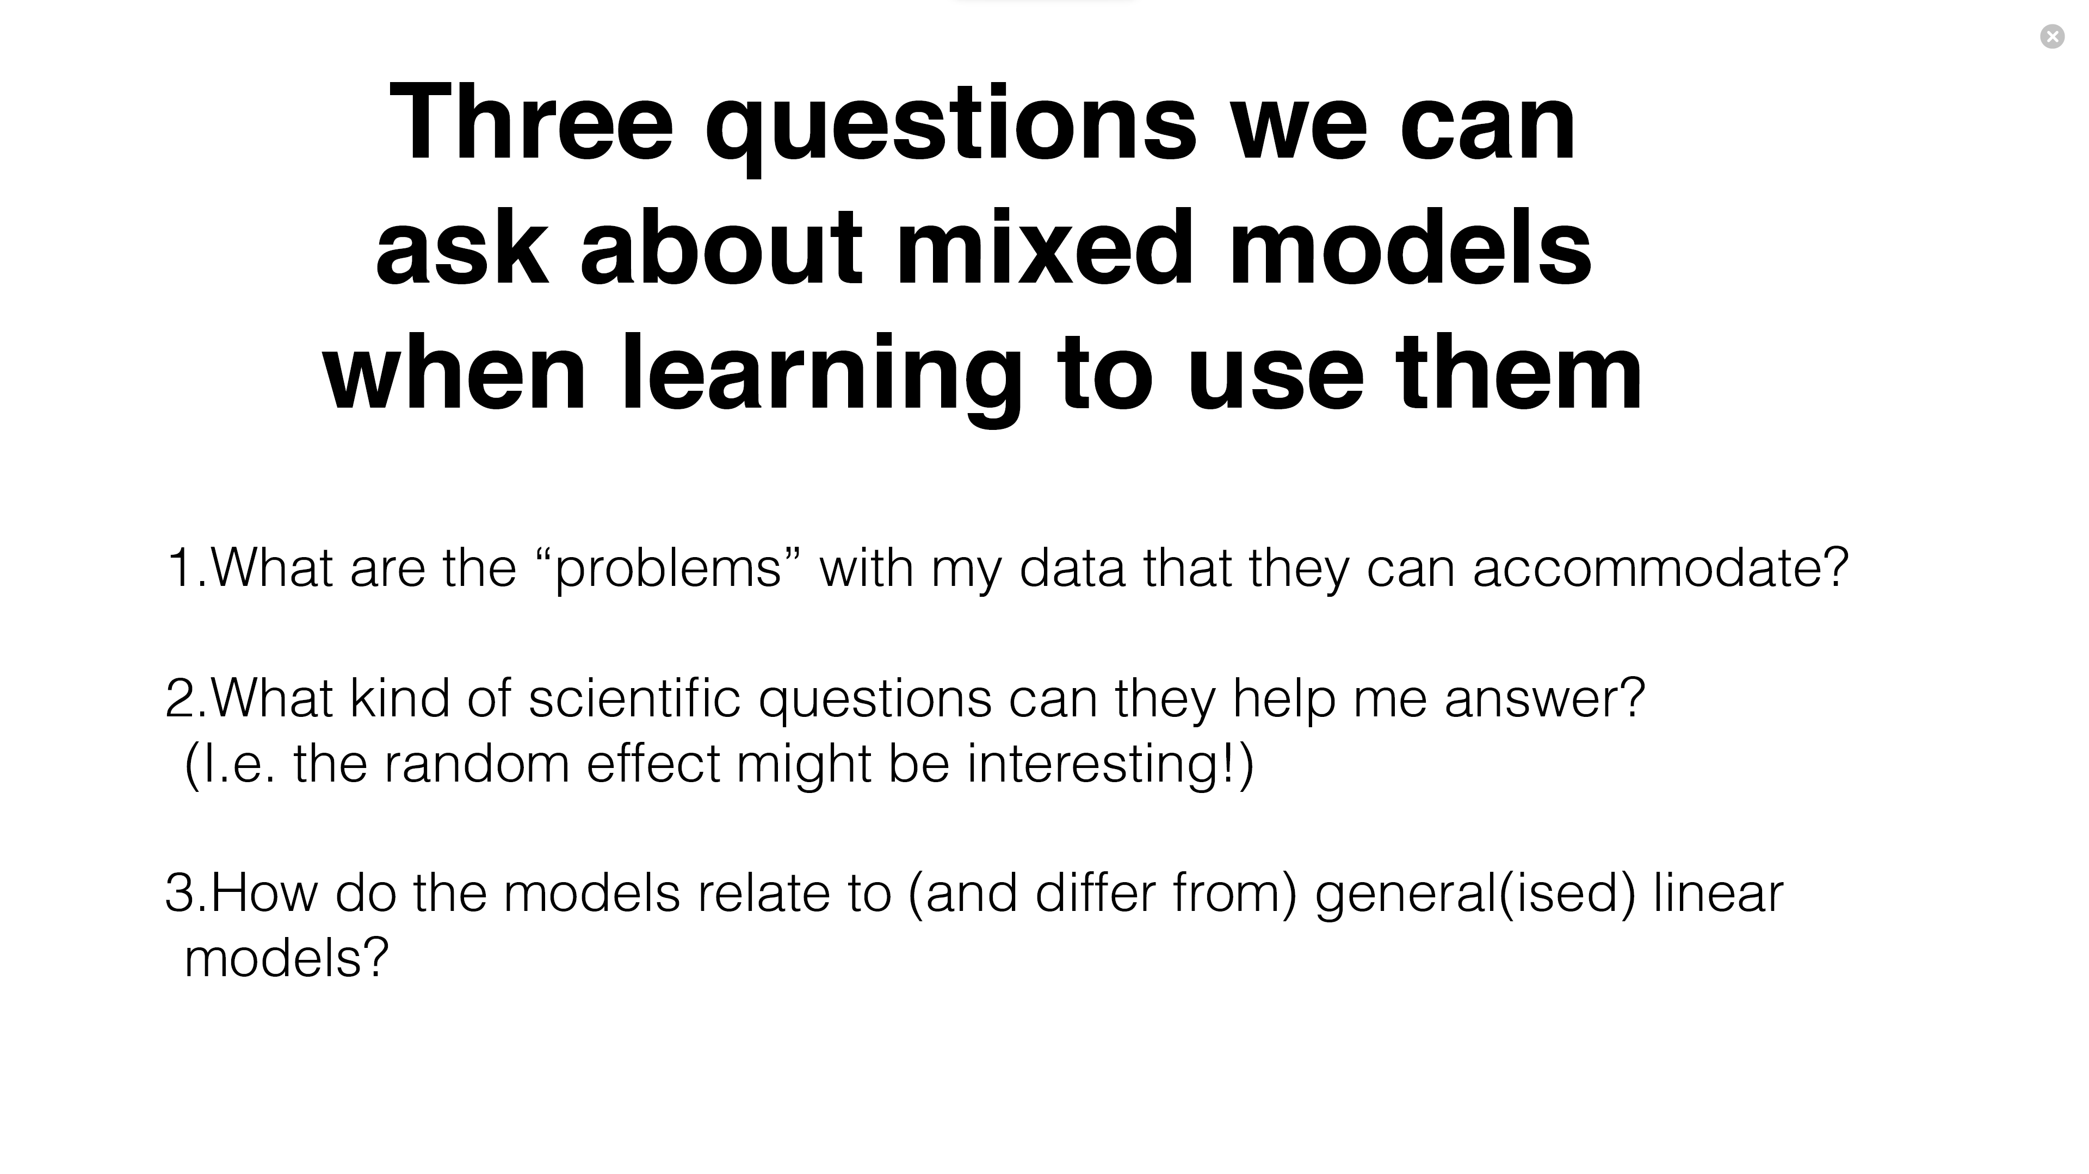

Slide 34


Slide 35
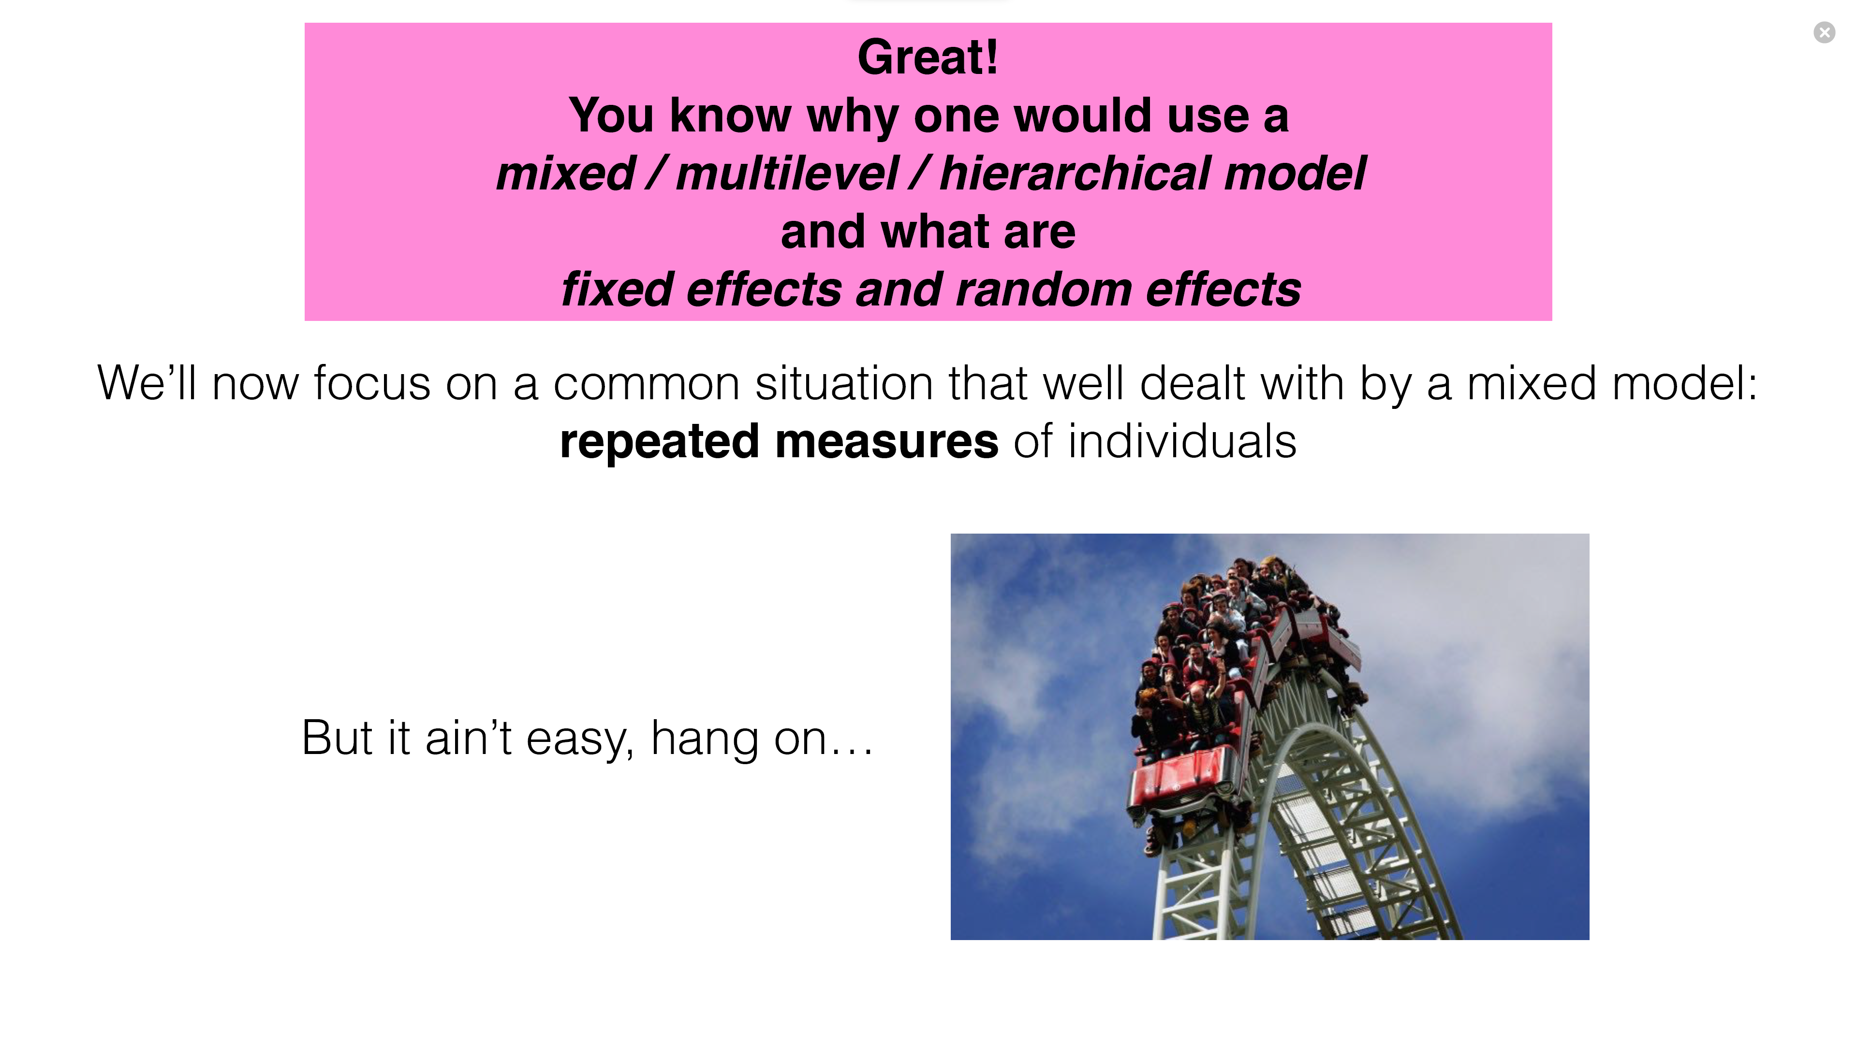

Slide 36
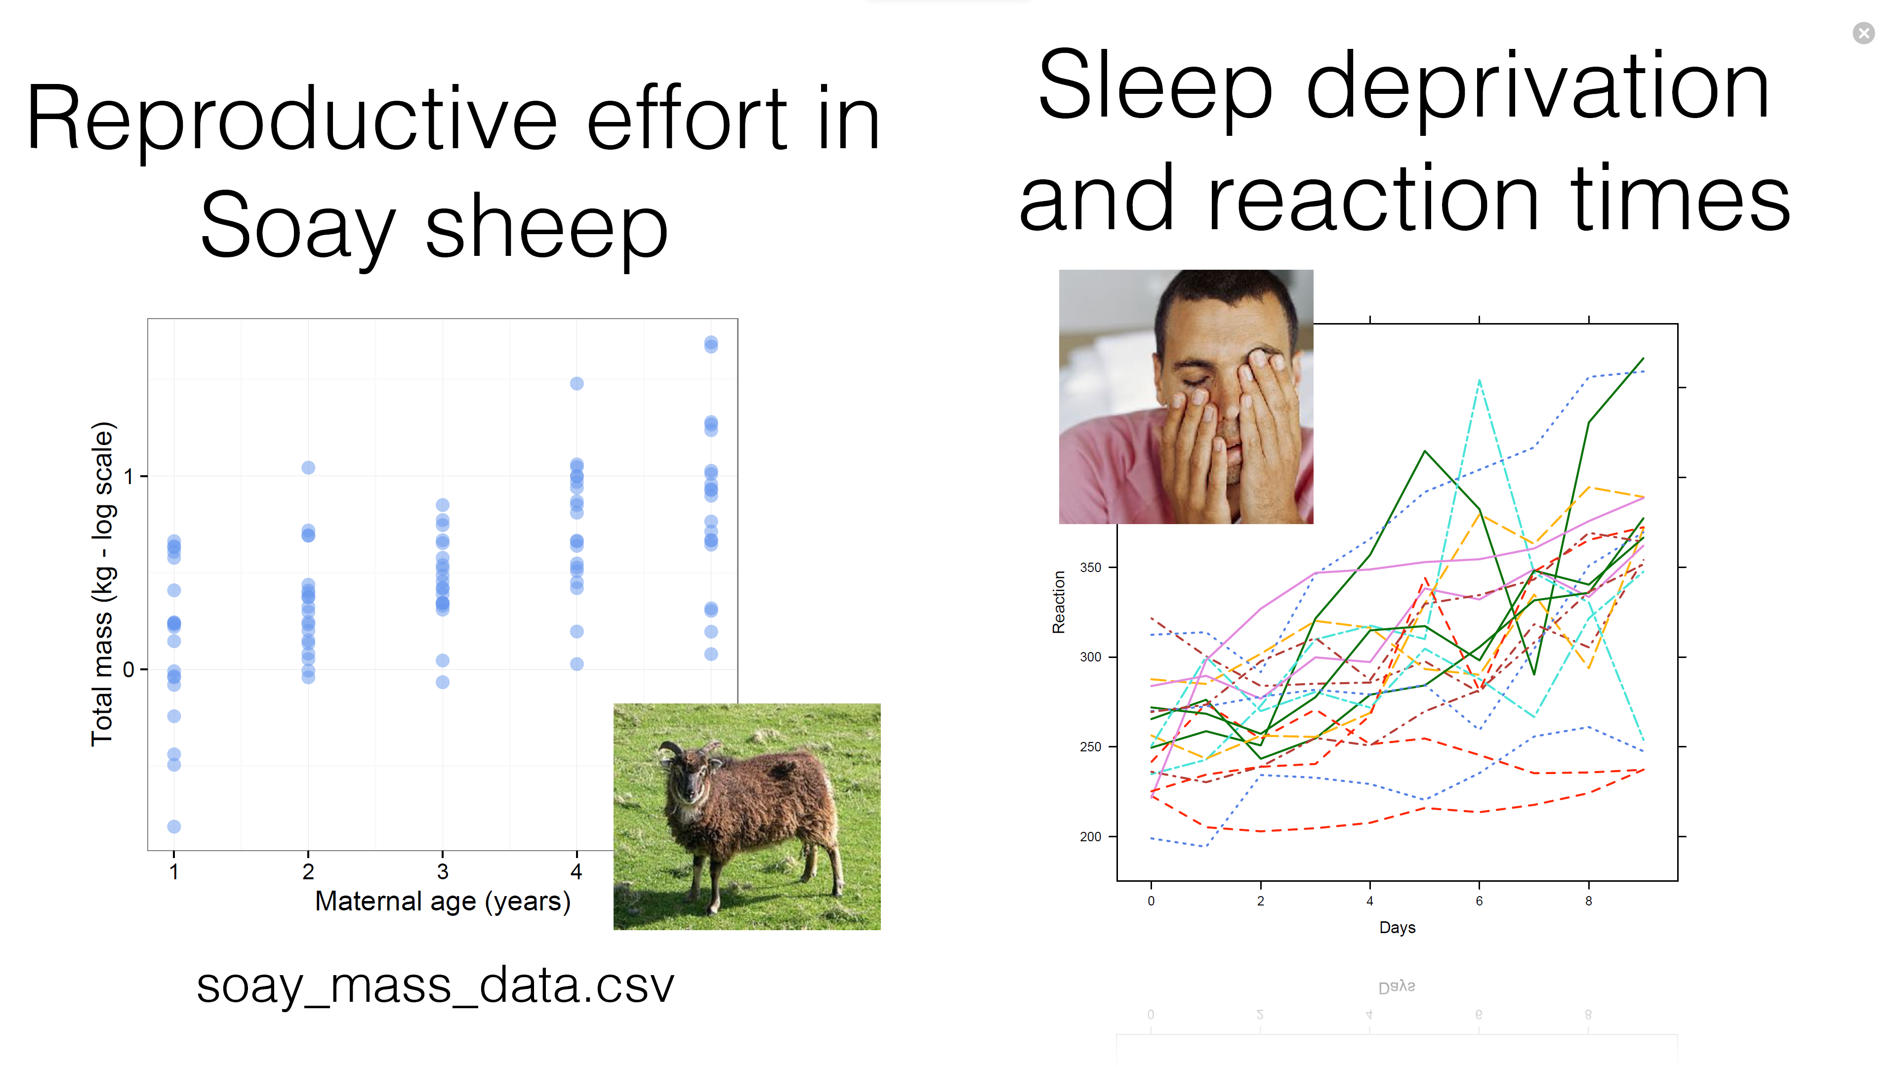

Slide 37
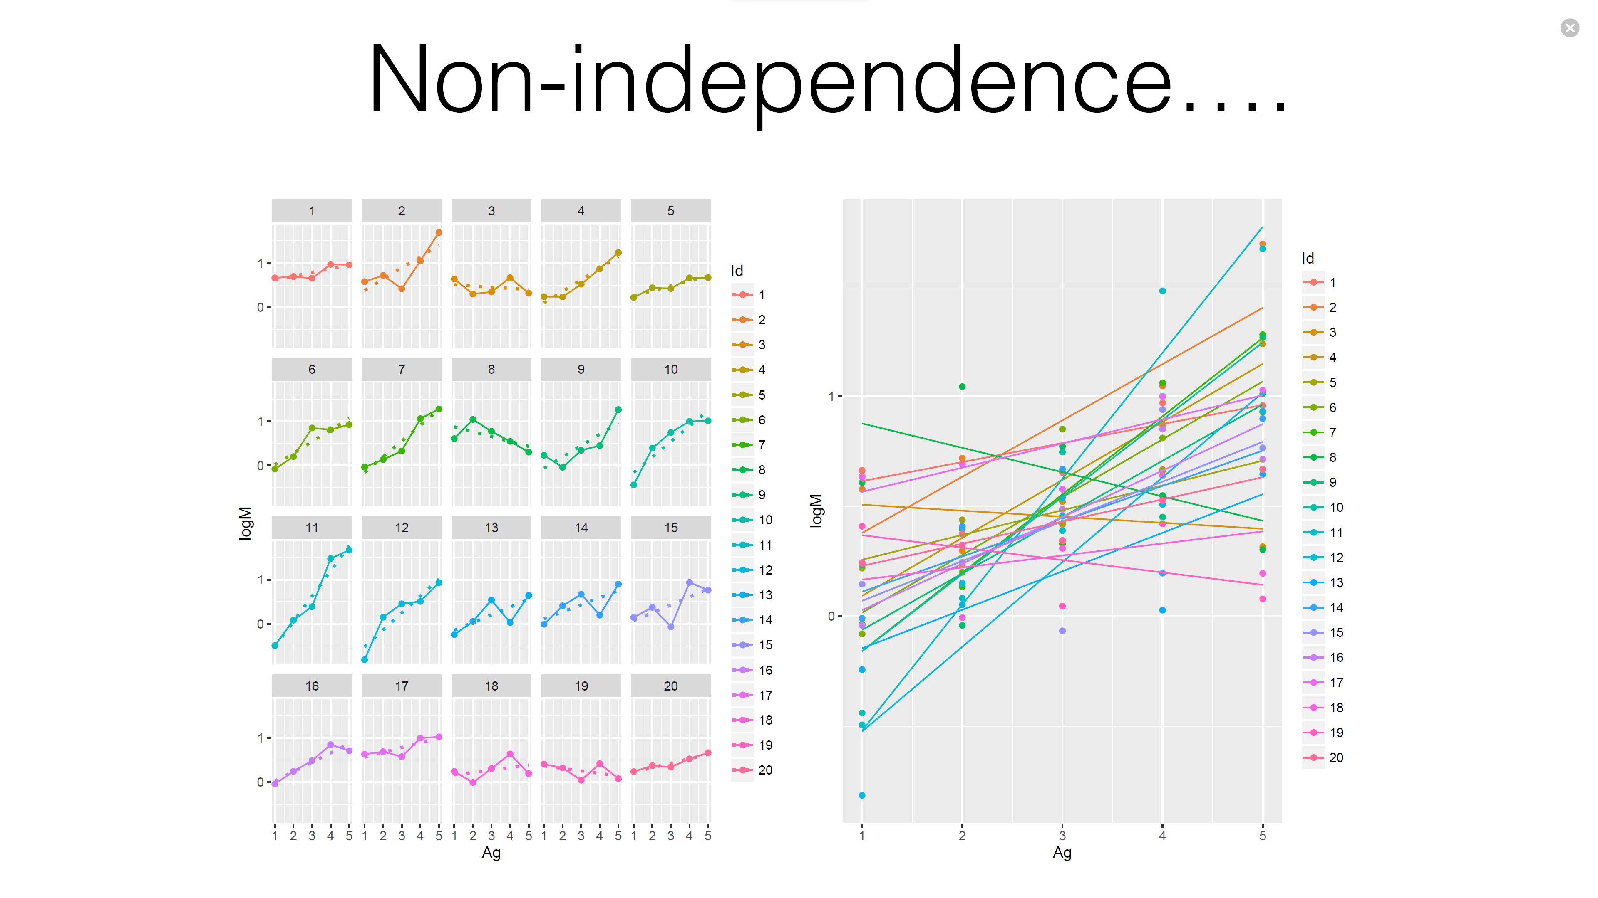

Slide 38
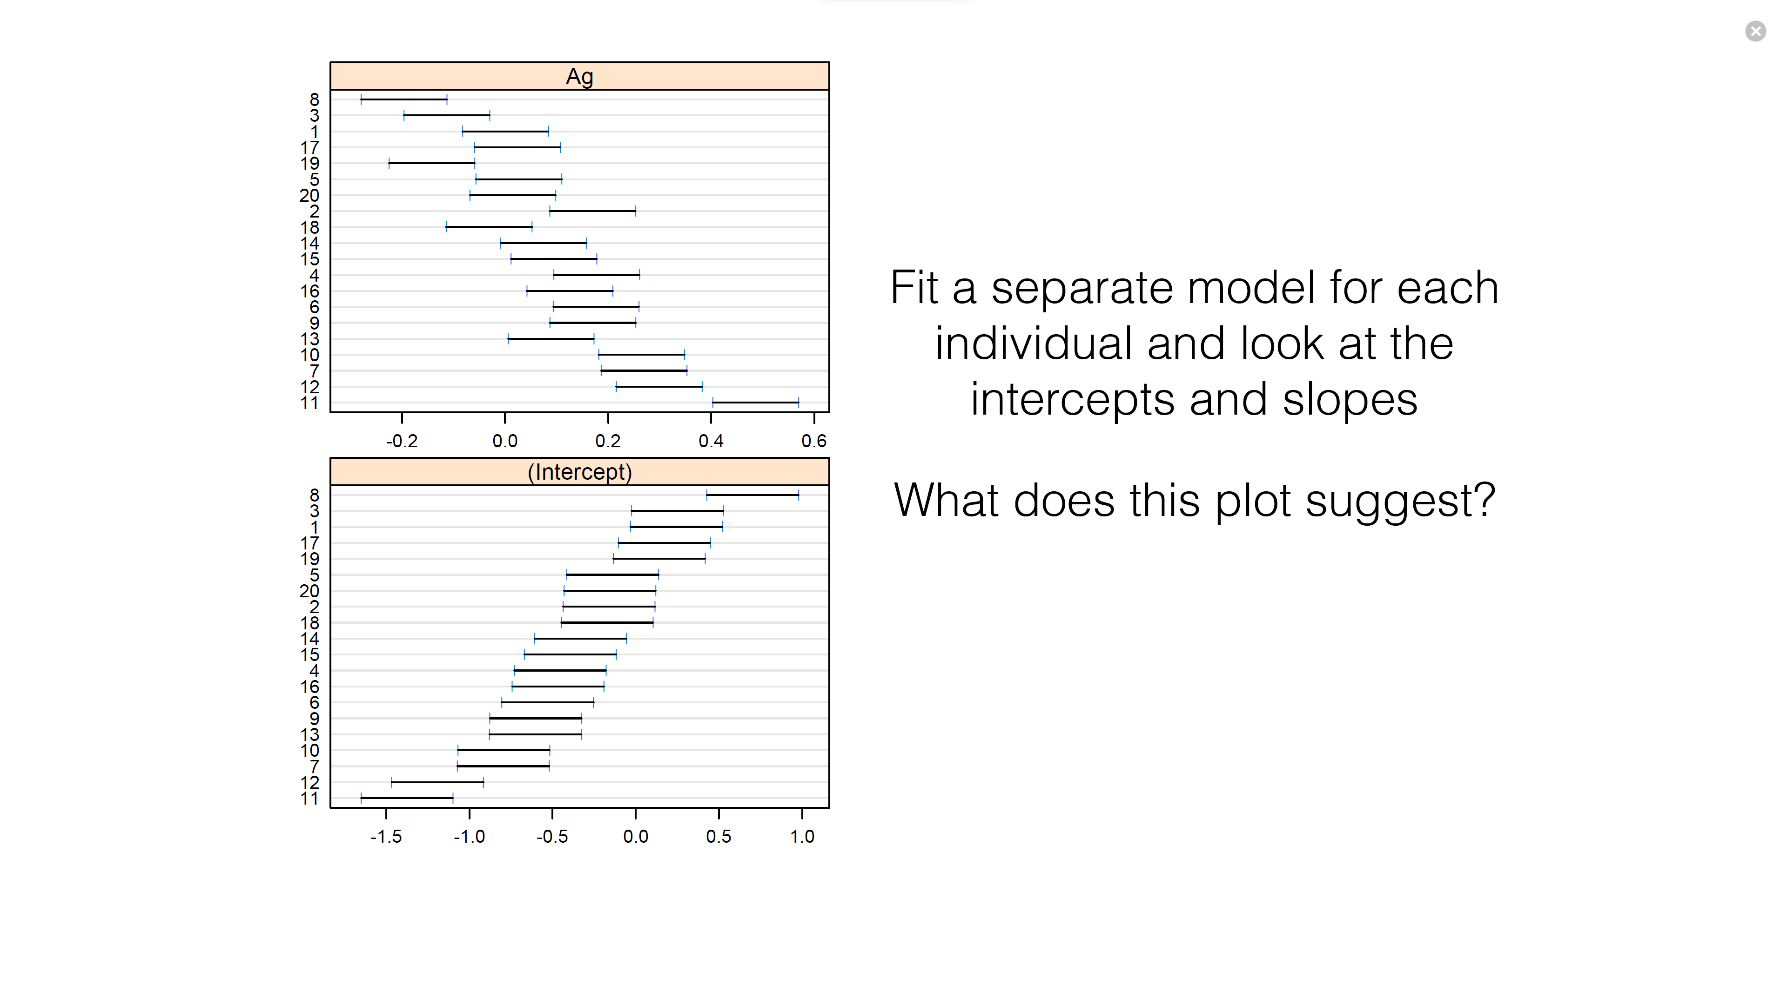

Slide 39
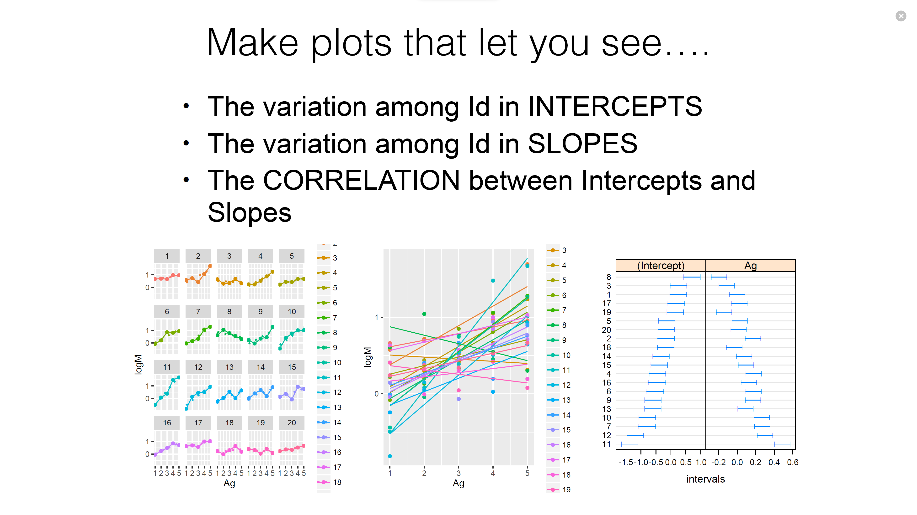

Slide 40
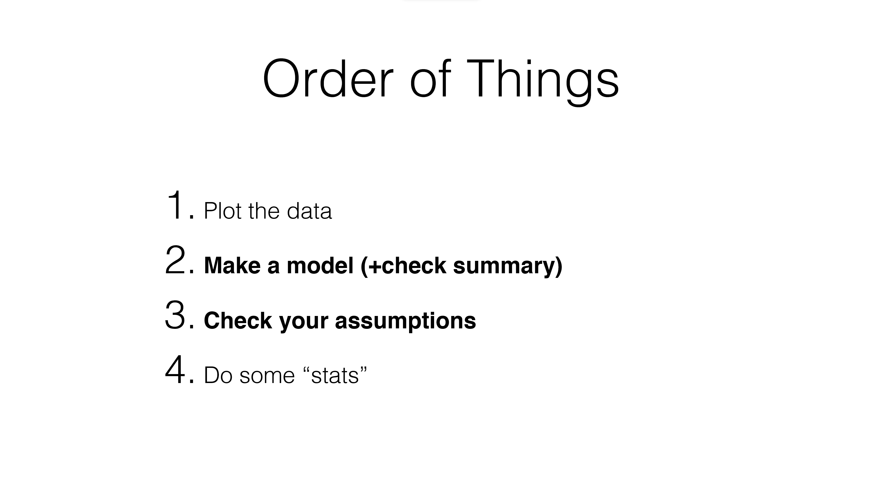

Slide 41
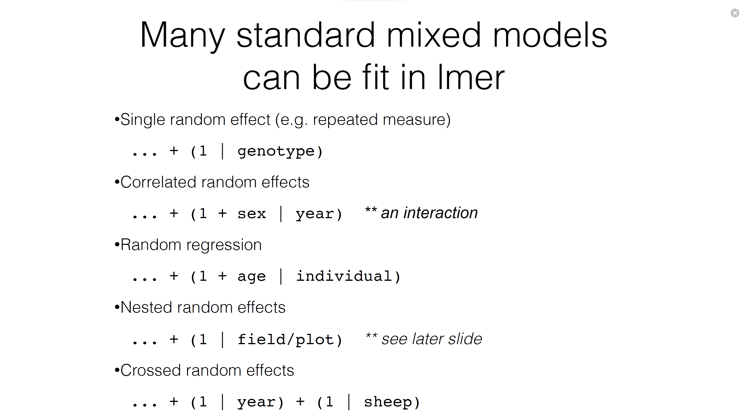

Slide 42
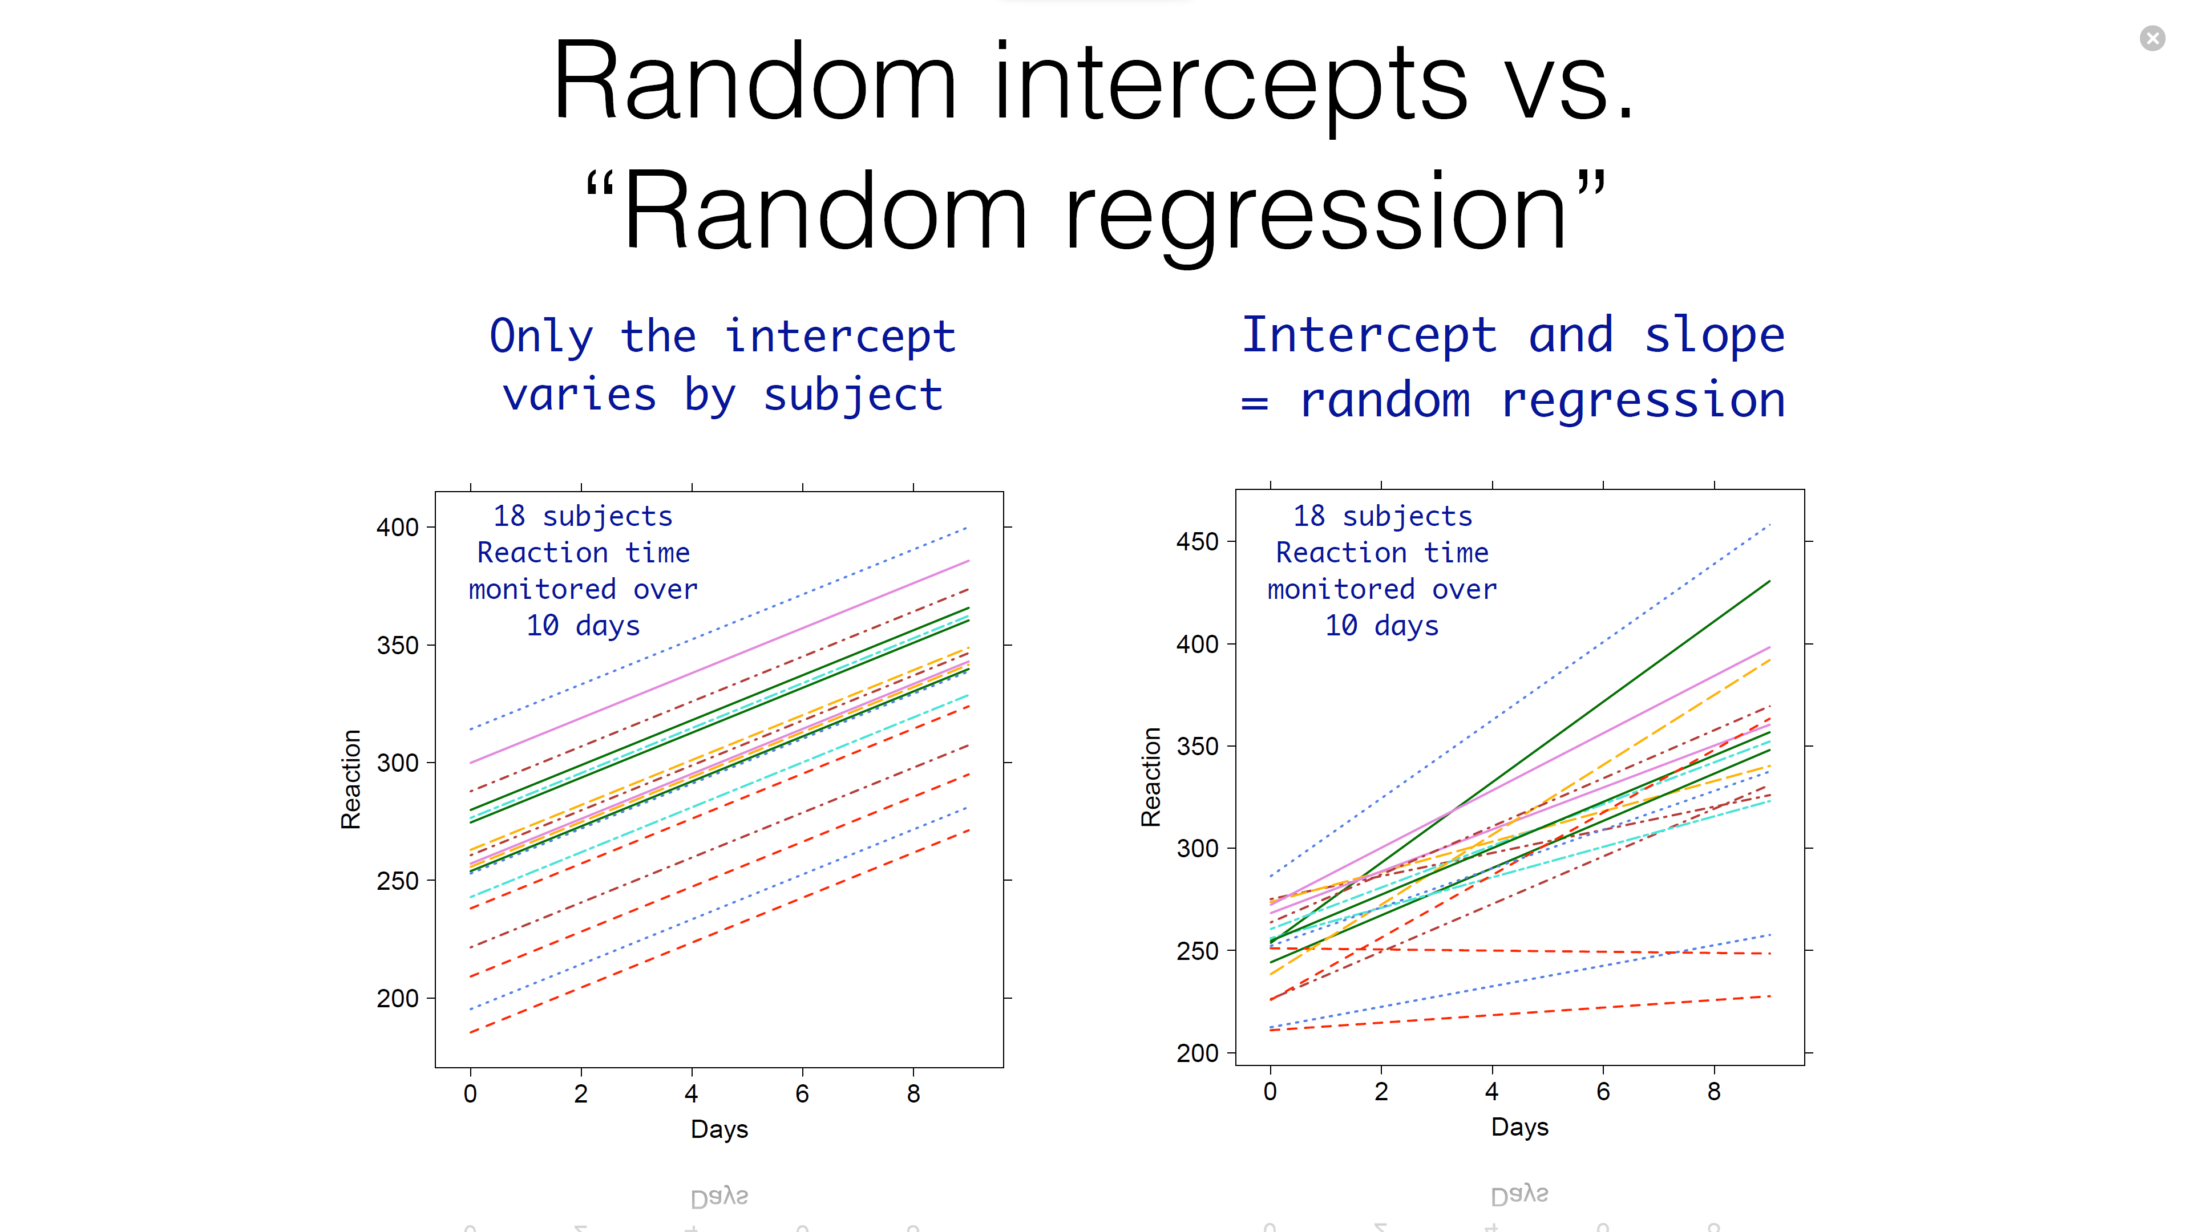

Slide 43
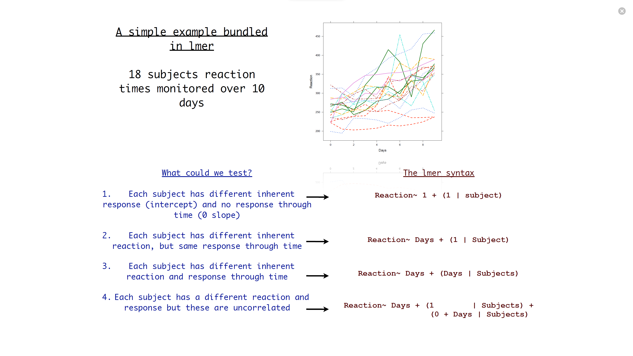

Slide 44
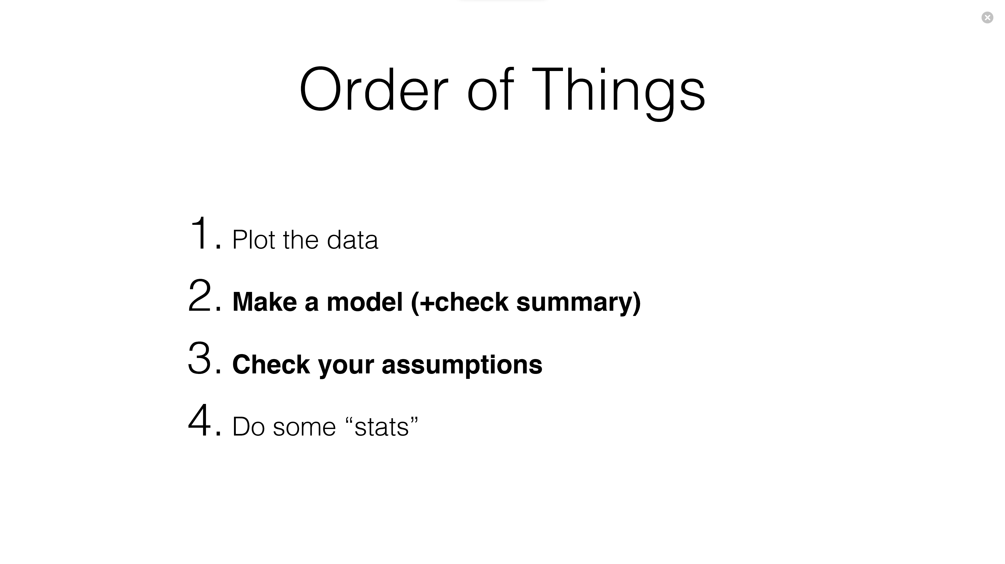

Slide 45
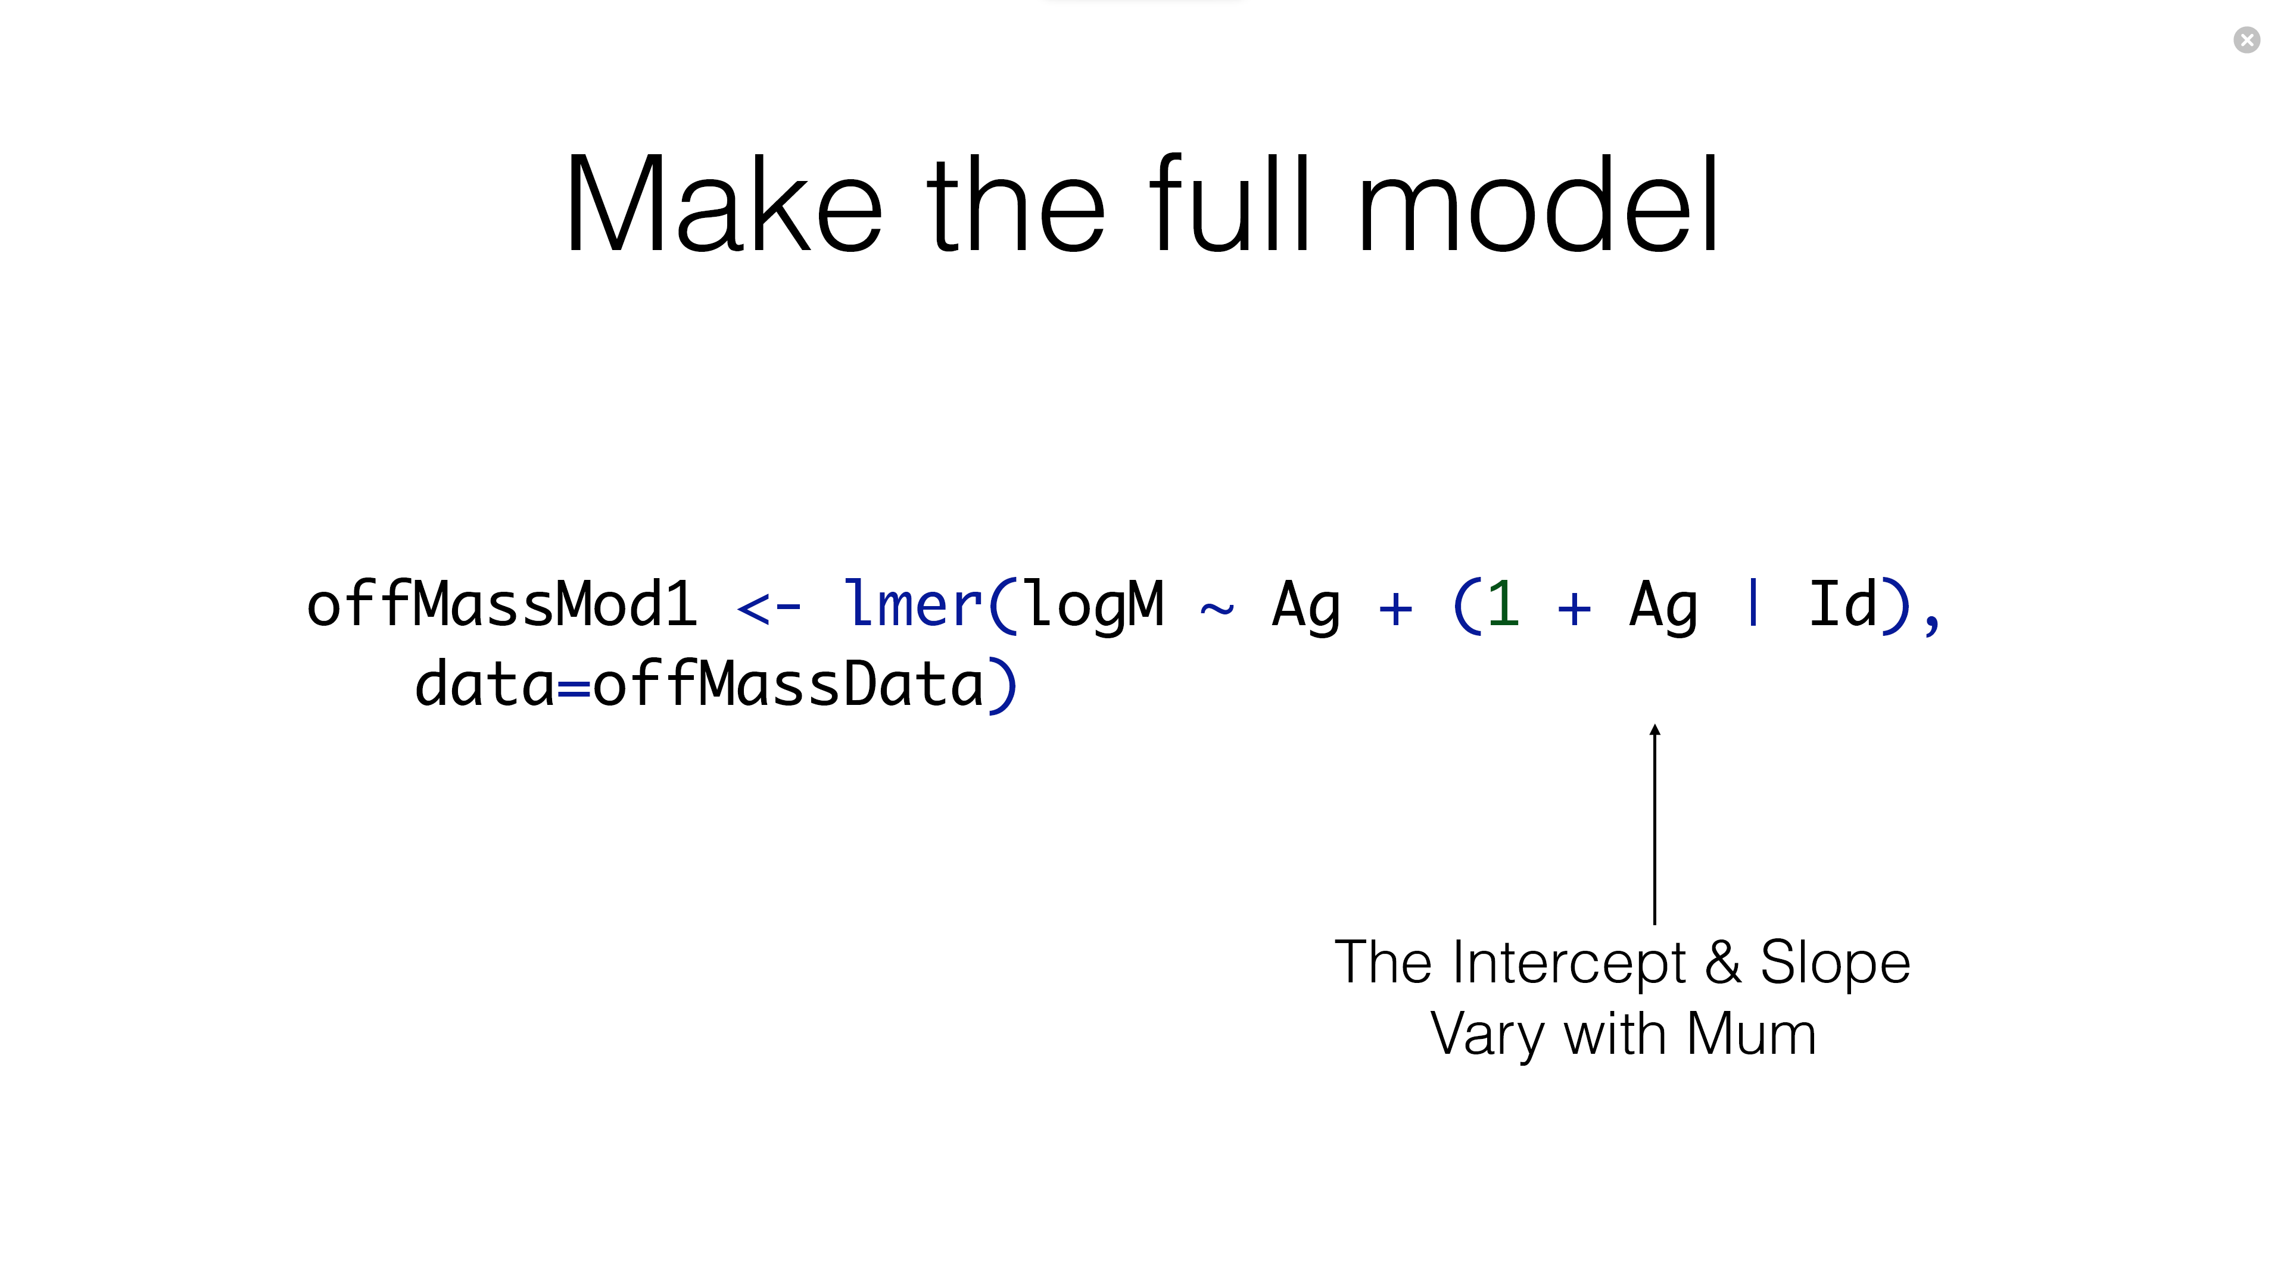

Slide 46
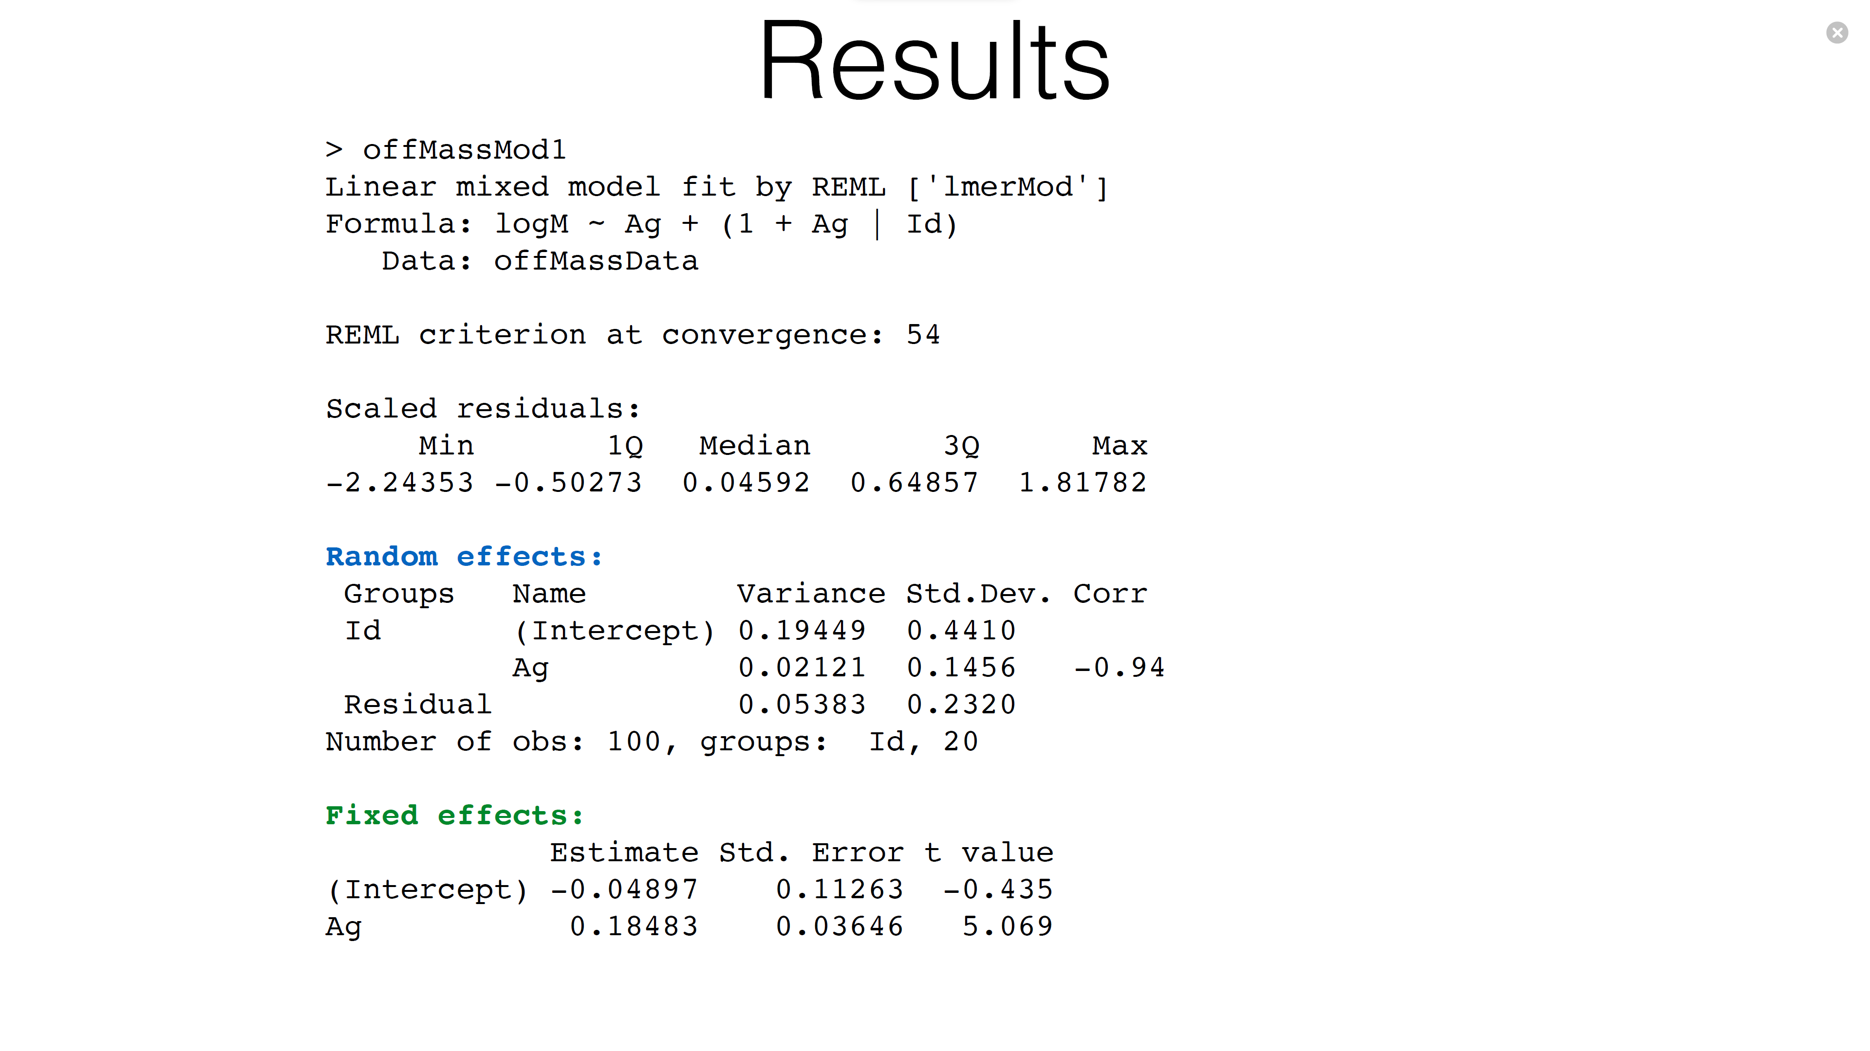

Slide 47
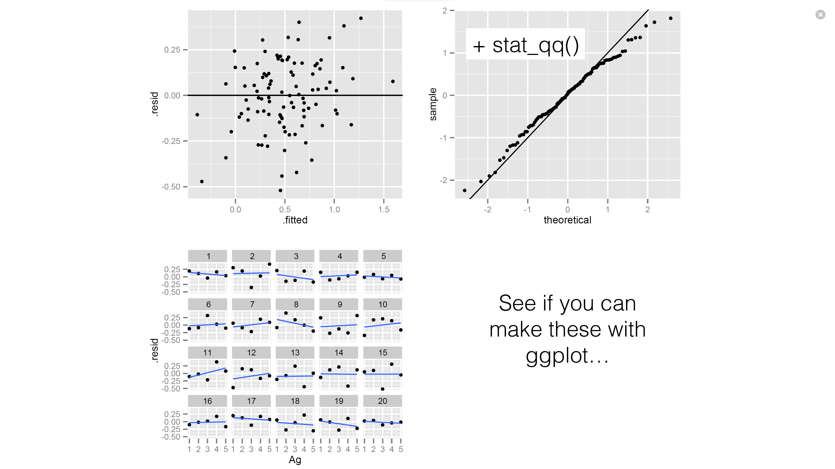

Slide 48
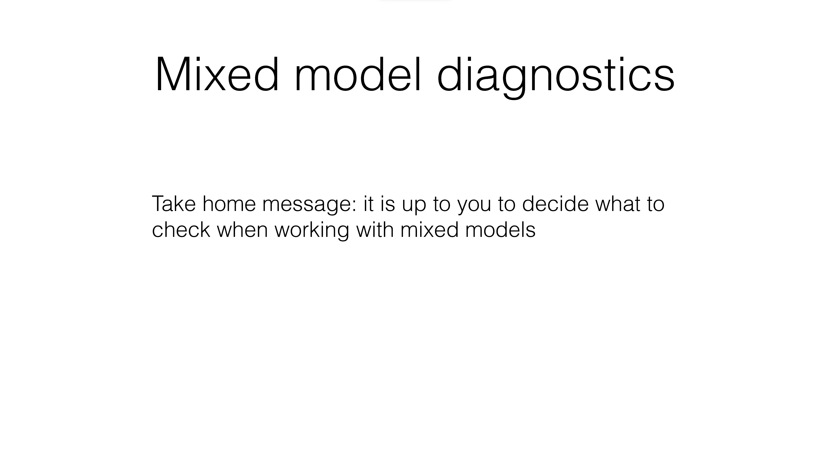

Slide 49
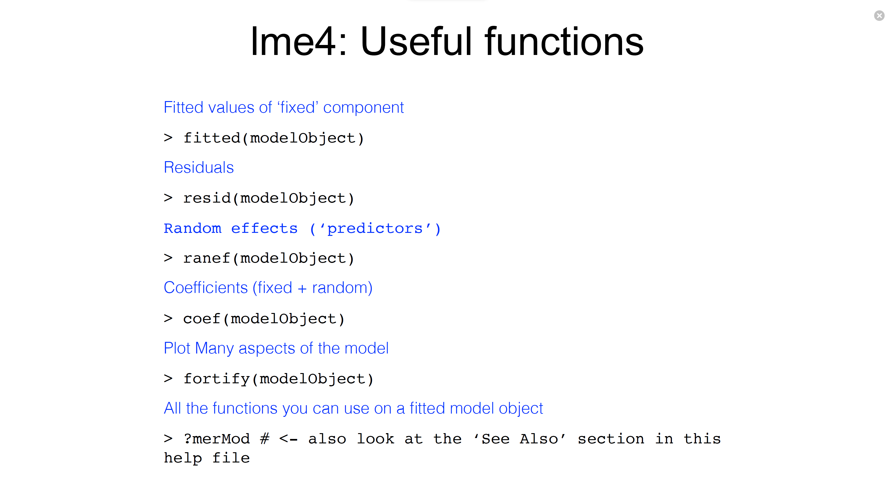

Slide 50
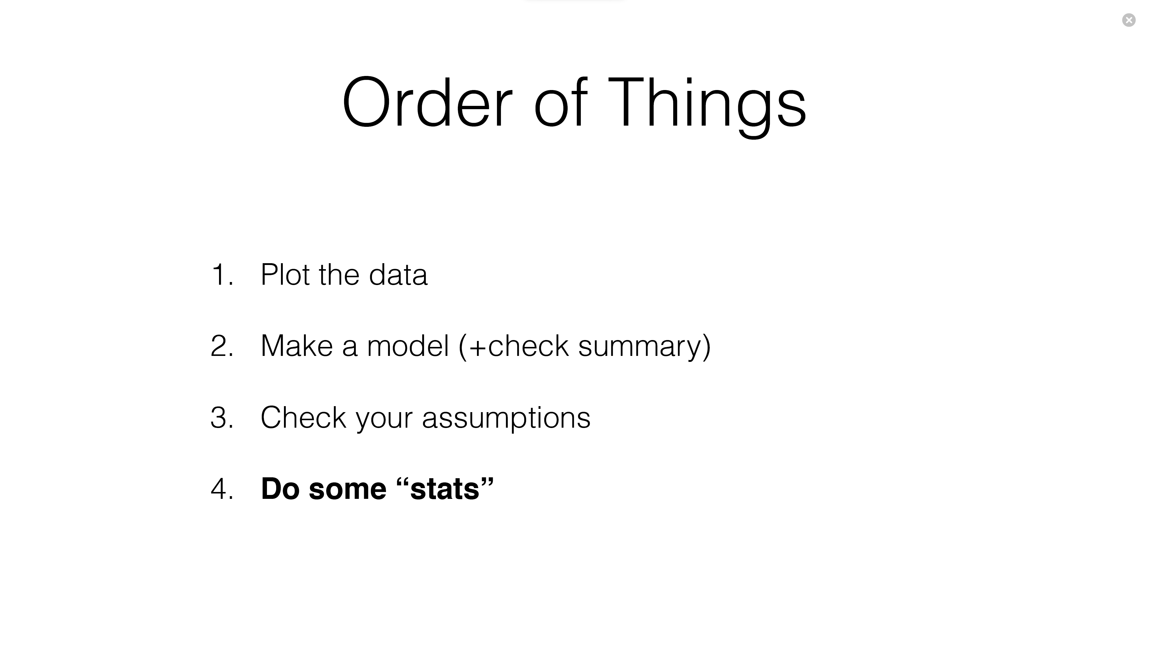

Slide 51
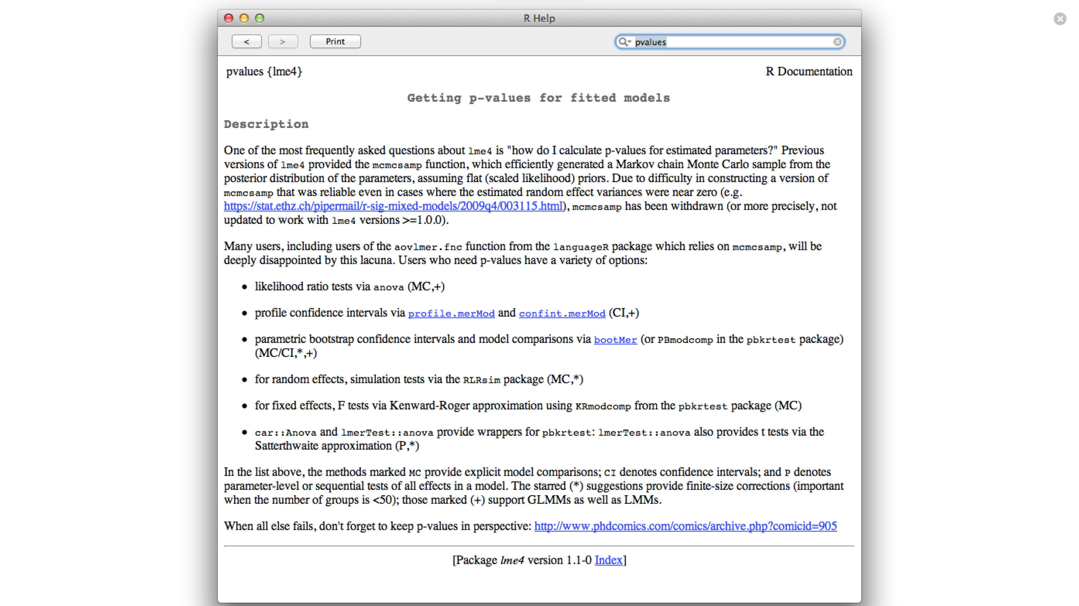

Slide 52
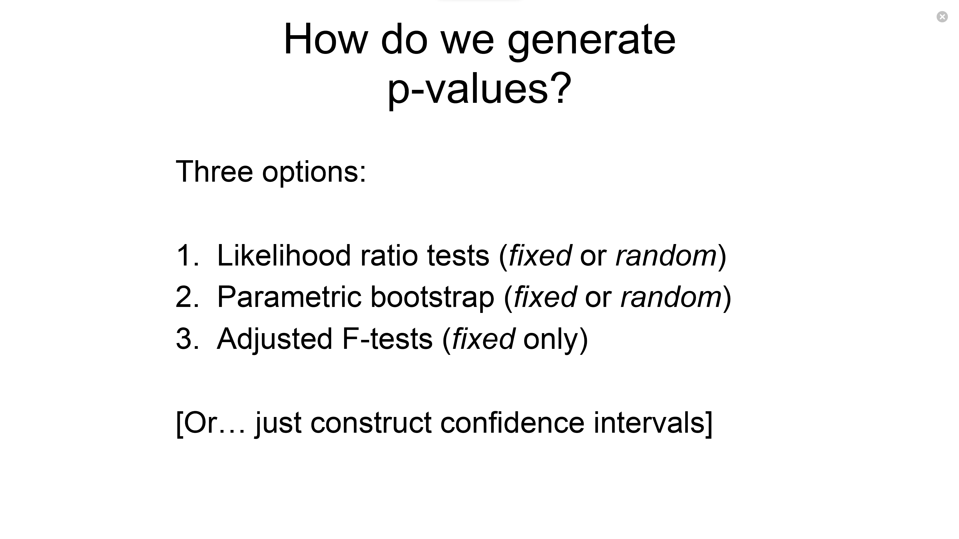

Slide 53


Slide 54


Slide 55


Slide 56


Slide 57


Slide 58


Slide 59


Slide 60


Slide 61


Slide 62


Slide 63


Slide 64


Slide 65


Slide 66


Slide 67


Slide 68


